Slide 1




Adenocarcinoma del pancreas :
Un tumore «raro» in aumento e ad alta mortalità
Giampaolo Tortora
Oncologia Medica
Facoltà di Medicina e Chirurgia
Università Cattolica del Sacro Cuore - Roma
UOC Oncologia Medica e Comprehensive Cancer Center
Fondazione Policlinico Universitario A.Gemelli - IRCCS, Roma

Slide 2
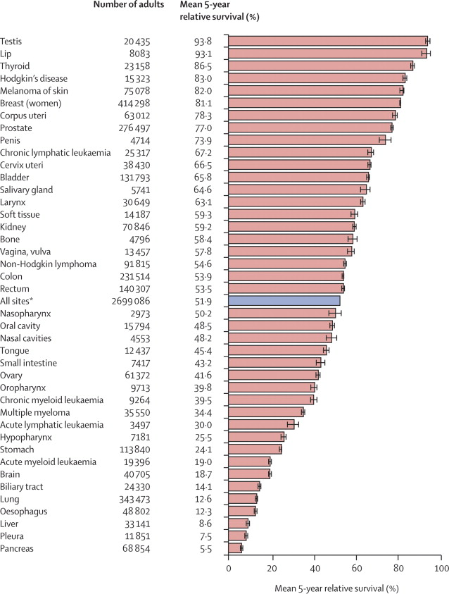
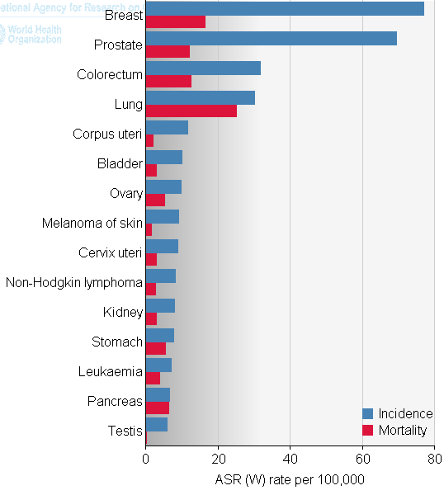
Pancreatic cancer : a disease with dismal prognosis
Incidence and mortality
Relatively rare disease (14th position) 2%/year increase in incidence
4th cause of cancer death; will be the 1st one in 2030 !!
Worst prognosis among all solid tumors (5% alive at 5 years) 90% die within 1 year
12.000 new cases / year in Italy

Slide 3
Pancreatic cancer epidemiology:
12.000 new cases per year in Italy
Stage | Incidence (%) | 5 year survival (%) | N° of cases
Resectable | 20% | 20% | 2400
Borderline resectable | 10% | 0-5% | 1200
Locally advanced/ unresectable | 30% | 0% | 3600
Metastatic | 40% | 0% | 4800

Slide 4
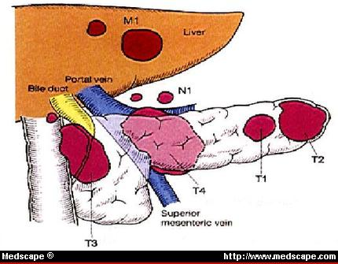
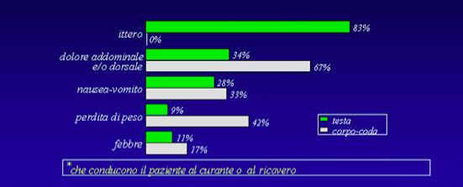
Sede e sintomi dei PDAC
Sede anatomica:
Testa del Pancreas : 75 % dei casi
Corpo : 15-20%
Coda : 5-10%
La diffusione è tipicamente prima per via linfatica, poi epatica, peritoneale e degli organi circostanti . Meno frequenti le metastasi polmonari
Notes:
Cancer Statistics, 2003. CA Cancer J Clin. 2003;53:5-26.
Salomon DS, Brandt R, Ciardiello F, et al. Epidermal growth factor-related peptides and their receptors in human malignancies. Crit Rev Oncol Hematol. 1995; 19:183-232.
Uegaki K, Nio Y, Inoue Y, et al. Clinicopathological significance of epidermal growth factor and its receptor in human pancreatic cancer. Anticancer Res. 1997; 7:3841-3847.
Abbruzzese JL, Rosenberg A, Xiong Q, et al. Phase II study of anti-epidermal growth factor receptor (EGFR) antibody cetuximab in combination with gemcitabine in patients with advanced pancreatic cancer. Proc Am Soc Clin Oncol. 2001; 20:518. Abstract.
SEER Cancer Statistics Review 1973-1998, National Cancer Institute. Available at http://seer.cancer.gov/Publications/CSR1973_1998/pancreas.pdf. Accessed June 26, 2001.

Slide 5
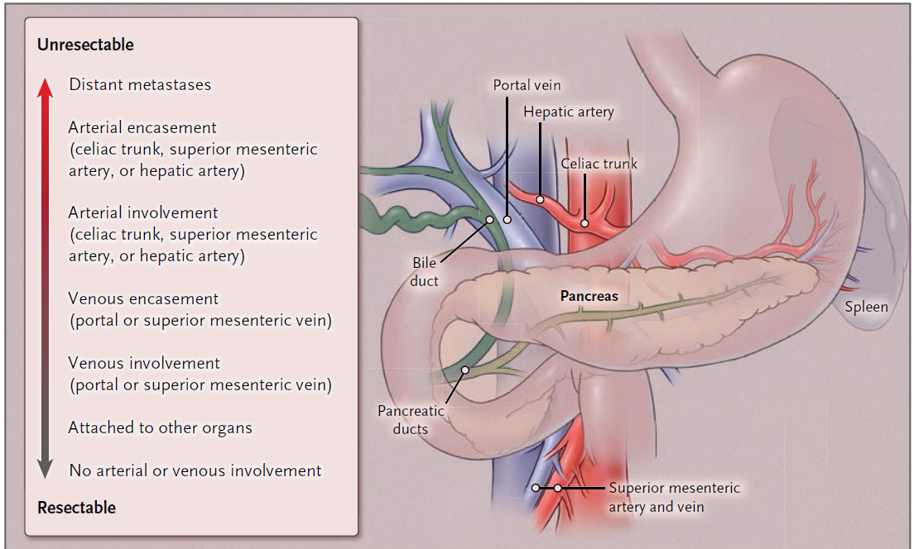
Pancreatic adenocarcinoma : Anatomy and resectability

Slide 6
Imaging of PDAC
E-US shows hypoechoic mass in the body of pancreas (no contrast).
Contrast-enhanced (CE-EUS) shows hypovascular area (right).
EUS guided FNA.
Transabdominal ultrasound shows hypoechoic mass lesion (arrows) in the head of pancreas (without contrast or enhancement).
Multidetector-row CT shows low-density mass, invading coeliac artery and stomach.
(C) PET-CT shows FDG uptake in the tail of pancreas.
(D) Gadolinium-enhanced MRI shows hypointensity mass (arrows) in the tail of pancreas.
(E) MR-cholangiopancreatography shows pancreatic duct stenosis of the main pancreatic duct with proximal dilation.
Kamisawa T. et al. Lancet 2016; 388: 73–85

Slide 7
Reasons for pancreatic tumor resistance to treatment
Abundant stroma (desmoplasia)
Variable, up to 80% of tumor mass
Hostile, hypoxic microenvironment with abnormal vascularization
Affects angiogenesis, metastatic spread, therapy resistance
High mutational rate (ICGC)

Slide 8
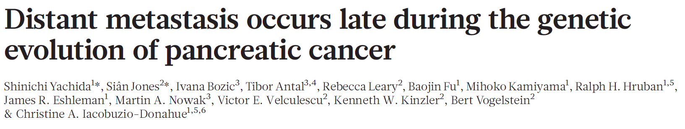
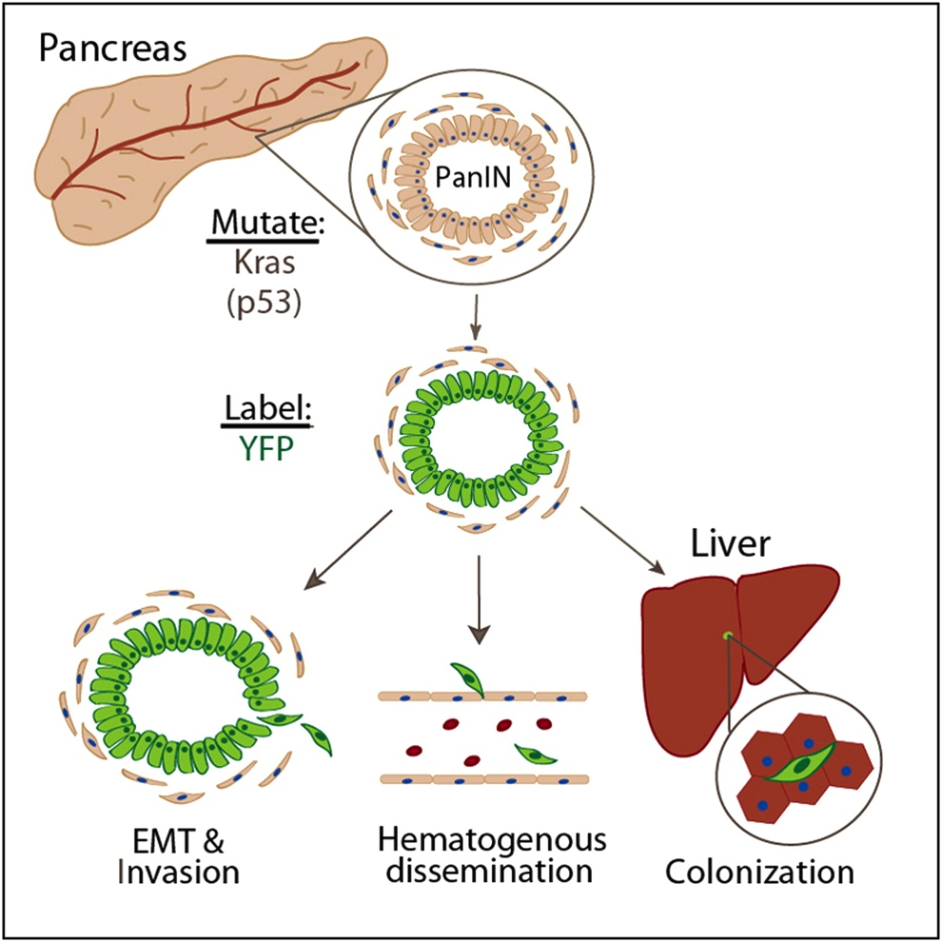
EMT and Dissemination precede pancreatic cancer formation
Yochida et al., Nature, 467: 114-19, 2010
Rhim AD, et al. Cell. 2012

Slide 9
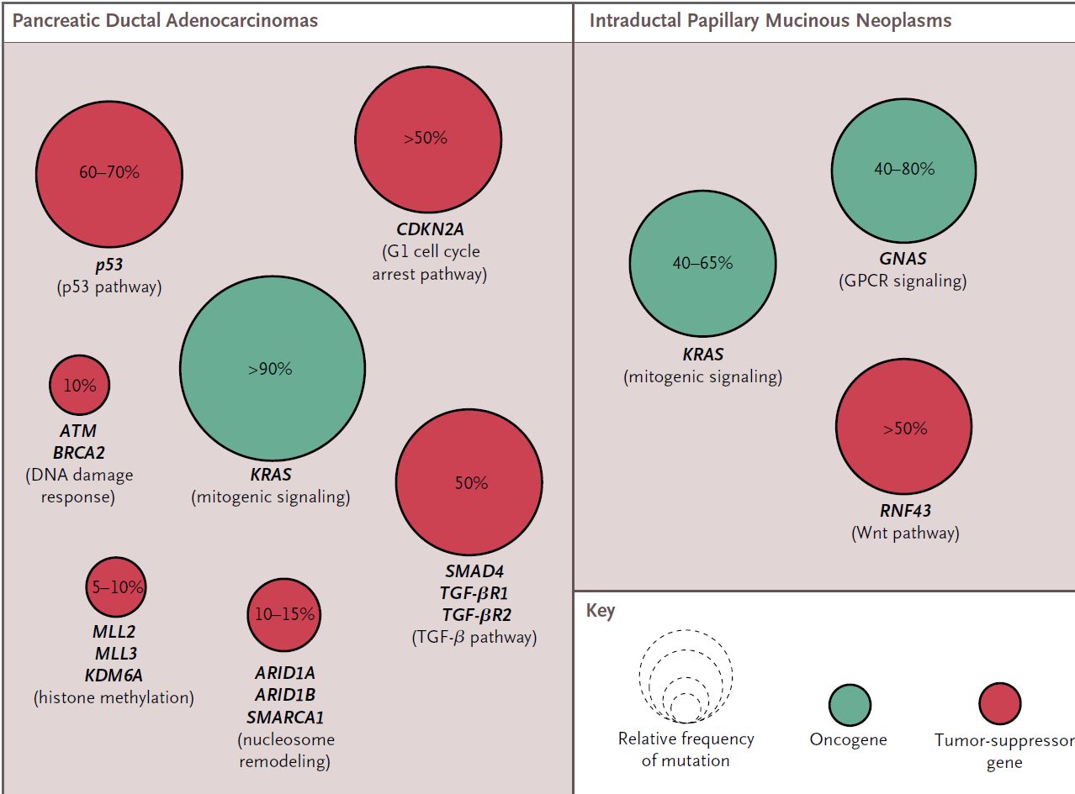

Main mutations in PDAC
Courtesy of Andrew Biankin
Ryan D et al. N Engl J Med 2014;371:1039-49.
Notes:
Approximate Frequencies of Mutations in Patients with Pancreatic Ductal Adenocarcinomas and Intraductal Papillary Mucinous
Neoplasms.
The two major precursors of pancreatic adenocarcinoma are pancreatic intraepithelial neoplasia and intraductal papillary mucinous neoplasms.
They have a distinct set of mutational events. Red circles indicate commonly mutated oncogenes, and green circles indicate tumor
suppressors. ARID1A denotes AT-rich interactive domain 1A; ARID1B AT-rich interactive domain 1B; ATM ataxia telangiectasia–mutated;
CDKN2A cyclin-dependent kinase inhibitor 2A; GNAS guanine nucleotide binding protein, alpha stimulating; GPCR G-protein–coupled
receptor; KDM6A lysine (K)-specific demethylase 6A; KRAS Kirsten rat sarcoma viral oncogene homologue; MLL2 mixed-lineage leukemia
2; MLL3 mixed-lineage leukemia 3; RNF43 ring-finger protein 43; SMAD4 SMAD family member 4; SMARCA1 SWI/SNF-related, matrixassociated,
actin-dependent regulator of chromatin, subfamily a, member 1; TGF-β transforming growth factor β; TGF-βR1 TGF-β receptor
1; and TGF-βR2 TGF-β receptor 2.

Slide 10
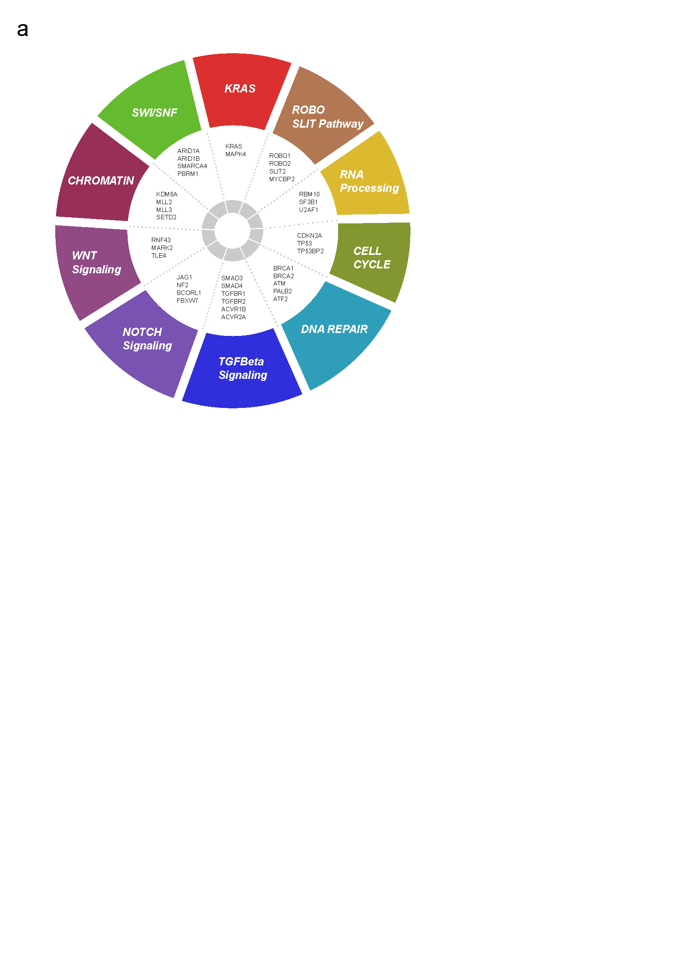
Key Molecular Mechanisms and Potential Vulnerabilities
(n = 457 multiplatform -omic analysis)
92%
14%
15%
24%
16%
25%
78%
Hudson et al. Nature 2010
Biankin et al. Nature 2012
Perez-Mancera et al. Nature 2012
Mann et al. PNAS 2012
Alexandrov et al. Nature 2013
Weissmueller et al. Cell 2014
Waddell et al. Nature 2015
Biankin et al. Nature 2015
24%
12%
47%
Biankin, Grimmond, Bailey, Chang et al. 2016

Slide 11
MALATTIA METASTATICA

Slide 12
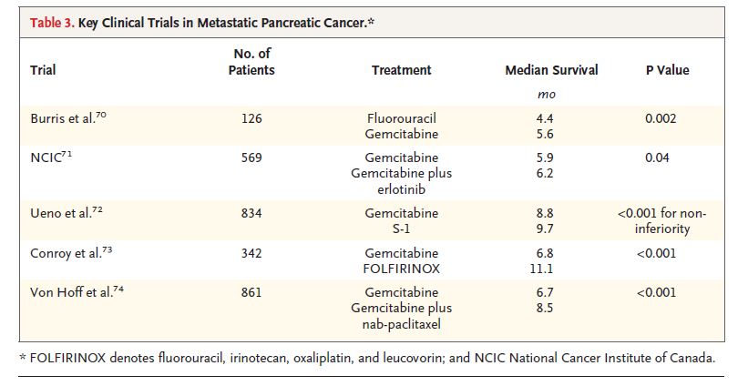
Metastatic pancreatic cancer
Ryan D et al. NEJM 2014

Slide 13
PRODIGE4 /ACCORD 11 : FOLFIRINOX vs Gemcitabine
PFS
OS
HR: 0.57 (95% CI: 0.45-0.73;
P < .001 by stratified log-rank test)
HR: 0.47 (95% CI: 0.37-0.59;
P < .001)
100
100
75
75
FOLFIRINOX 6.4 mos.
Patients Without Progresion (%)
FOLFIRINOX 11.1 mos.
50
Gemcitabine 3.3 mos
50
Gemcitabine 6.8 mos
Patients Alive (%)
25
25
0
0
0
3
6
9
12
15
18
21
24
27
30
33
36
39
42
0
3
6
9
12
15
18
21
24
27
30
33
36
Months
Months
Pts at Risk, n
Pts at Risk, n
Gemcitabine
171
134
89
48
28
14
7
6
3
3
2
2
2
2
1
Gemcitabine
171
88
26
8
5
2
0
0
0
0
0
0
0
FOLFIRINOX
171
146
116
81
62
34
20
13
9
5
3
2
2
2
2
FOLFIRINOX
171
121
85
42
17
7
4
1
1
0
0
0
0
Conroy T, et al. N Eng J Med. 2011;364:1817-1825.
Notes:
13

Slide 14

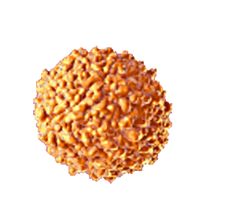

Nanomedicine – nab-Paclitaxel
nab-Paclitaxel individual molecule
nab-Paclitaxel complex
4-14 nm in size^{3,4}
Albumin
Paclitaxel
130 nm in size^{1,2}
A single molecule of albumin can bind up to 6 or 7 molecules of paclitaxel⁵
Desai et al. SABCS. 2004 [Abstract 1071].
Kratz et al. J Control Release. 2008;132(3):171-183.
Peters,Jr. Serum albumin. Adv Protein Chem. 1985;37:161-245.
Desai. Drug Delivery Report. 2008;Winter 2007/2008(16):35-41.
Paal et al. Eur J Biochem. 2001;268:2187-2191.

Slide 15
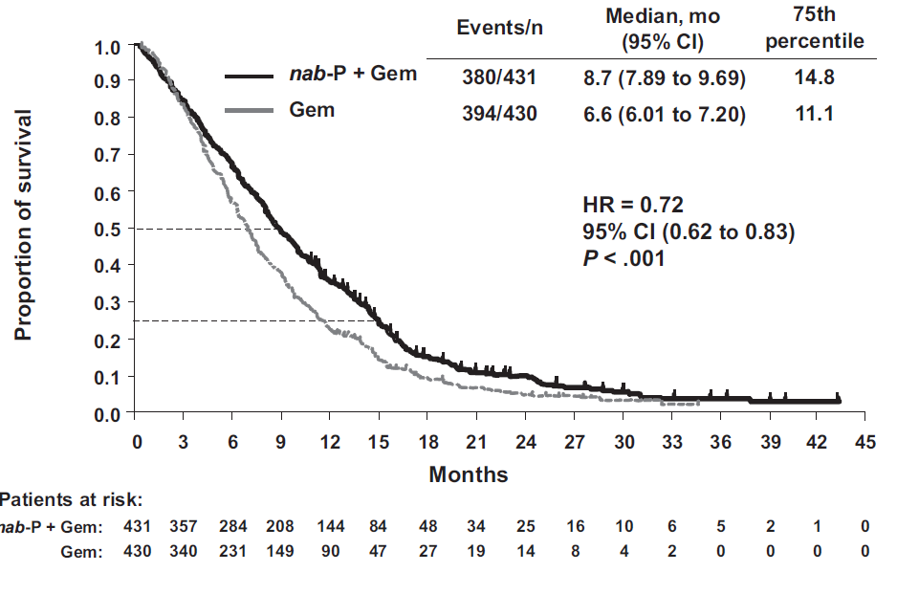
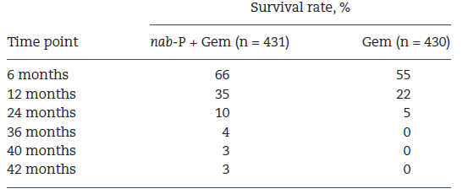
Updated overall survival (intent-to-treat population)
Goldstein D. et al J Natl Cancer Inst. 107:1691-1703, 2015

Slide 16
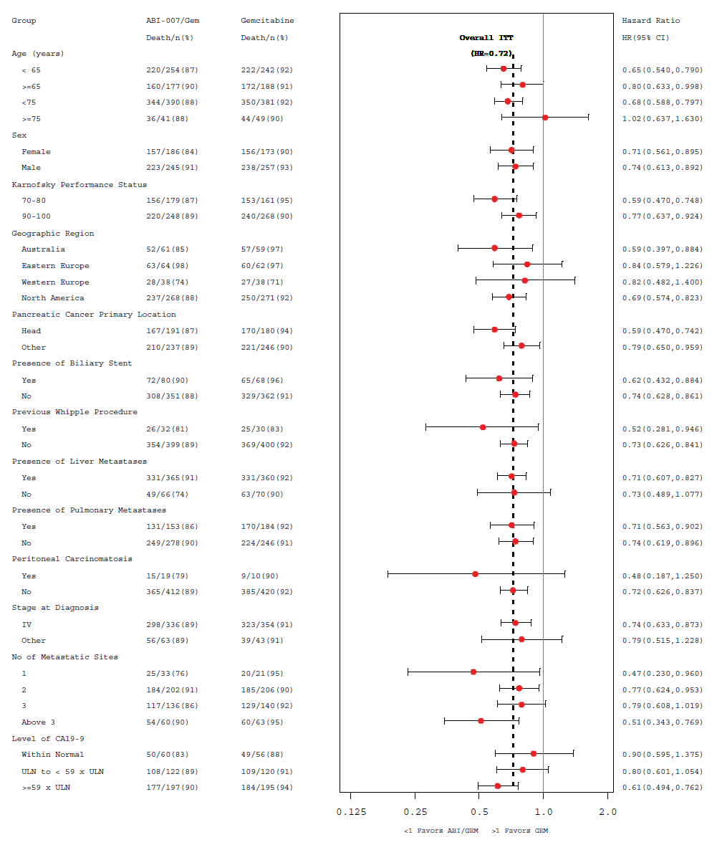
OS update for prespecified subgroups
nab-P + Gem |  | Gem |  | HR | P Value
Events/n | Median OS, mo | Events/n | Median OS, mo
380/431 | 8.7 | 394/430 | 6.6 | 0.72 | < 0.0001
220/254 | 9.6 | 222/242 | 6.8 | 0.65 | < 0.0001
160/177 | 7.7 | 172/188 | 6.5 | 0.80 | 0.0484
157/186 | 9.7 | 156/173 | 7.1 | 0.71 | 0.0039
223/245 | 8.1 | 238/257 | 6.2 | 0.74 | 0.0016
156/179 | 7.6 | 153/161 | 4.3 | 0.59 | < 0.0001
220/248 | 9.7 | 240/268 | 7.9 | 0.77 | 0.0053
167/191 | 9.5 | 170/180 | 6.4 | 0.59 | < 0.0001
210/237 | 8.1 | 221/246 | 6.9 | 0.79 | 0.0171
331/365 | 8.3 | 331/360 | 5.9 | 0.71 | < 0.0001
49/66 | 11.1 | 63/70 | 10.2 | 0.73 | 0.1109
25/33 | 12.9 | 20/21 | 9.0 | 0.47 | 0.0384
184/202 | 8.6 | 185/206 | 6.9 | 0.77 | 0.0164
117/136 | 7.9 | 129/140 | 5.9 | 0.79 | 0.0688
54/60 | 8.7 | 60/63 | 5.0 | 0.51 | 0.0012
50/60 | 9.3 | 49/56 | 7.0 | 0.90 | 0.6401
108/122 | 8.8 | 109/120 | 7.3 | 0.80 | 0.1114
177/197 | 8.4 | 184/195 | 5.7 | 0.61 | < 0.0001
52/61 | 9.4 | 57/59 | 6.7 | 0.59 | 0.0104
63/64 | 7.7 | 60/62 | 5.9 | 0.84 | 0.3715
28/38 | 10.7 | 27/38 | 6.9 | 0.82 | 0.4705
237/268 | 8.8 | 250/271 | 6.6 | 0.69 | < 0.0001
Group
HR
All patients
Age < 65 years
Age ≥ 65 years
Female
Male
KPS 70 - 80
KPS 90 - 100
Primary tumour location: head
Primary tumour location: other
Liver metastases
No liver metastases
1 metastatic site
2 metastatic sites
3 metastatic sites
> 3 metastatic sites
Normal CA 19-9
CA 19-9 ULN to < 59 × ULN
CA 19-9 ≥ 59 × ULN
Australia
Eastern Europe
Western Europe
North America
0.125
0.25
0.5
1.0
2.0
Favors nab-P + Gem
Favors Gem
Goldstein D. et al J Natl Cancer Inst. 107:1691-1703, 2015

Slide 17
II Linea e III Linea

Slide 18
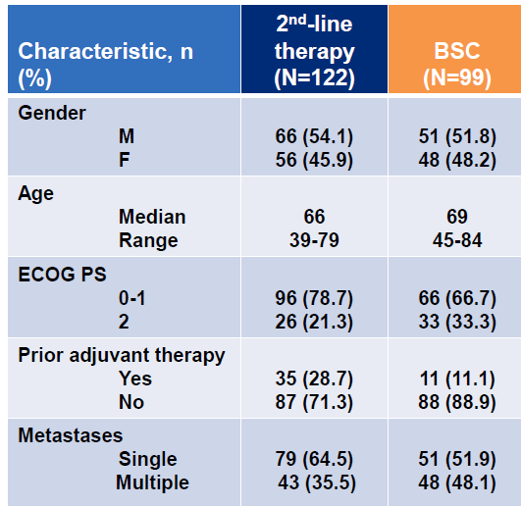
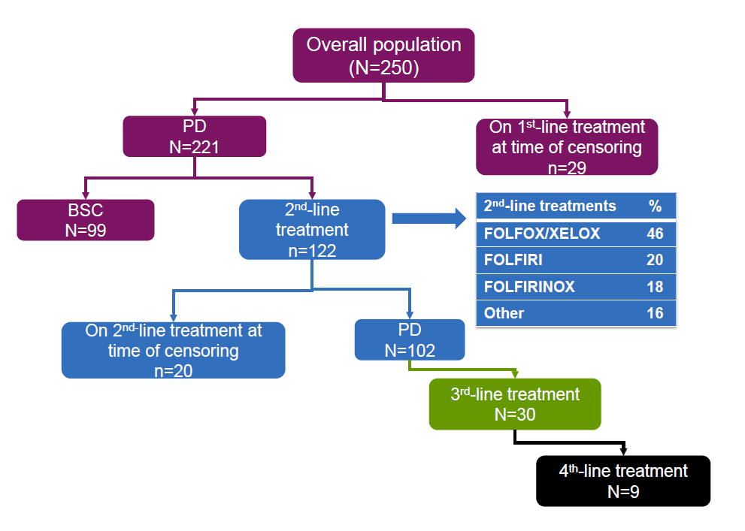
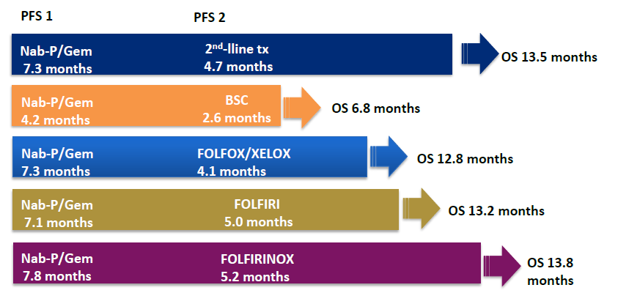
2nd-line treatment is feasible after 1st-line
nab-paclitaxel + gemcitabine
Giordano et al. ASCO 2016 (abstract 4124)
Notes:
18

Slide 19
Positive randomized trials of II line therapies for pancreatic cancer
Garrido-Laguna I. and Hidalgo M Nature Reviews Clinical Oncology 2015
Notes:
19

Slide 20
Terapia adiuvante
Notes:
20

Slide 21
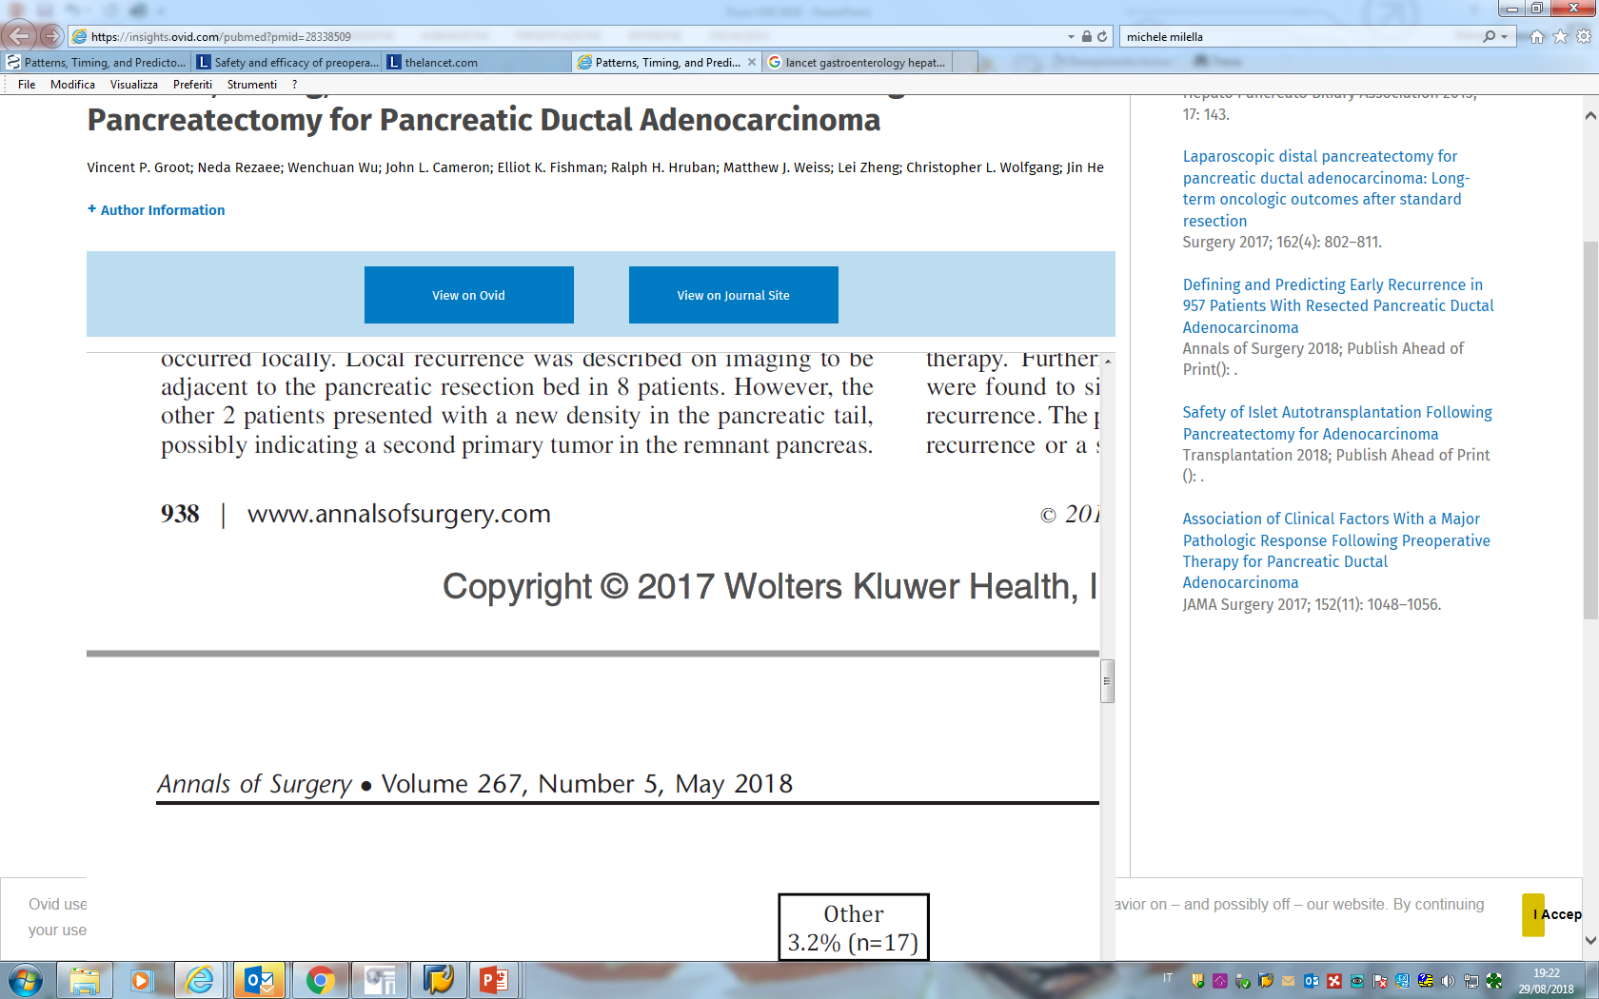
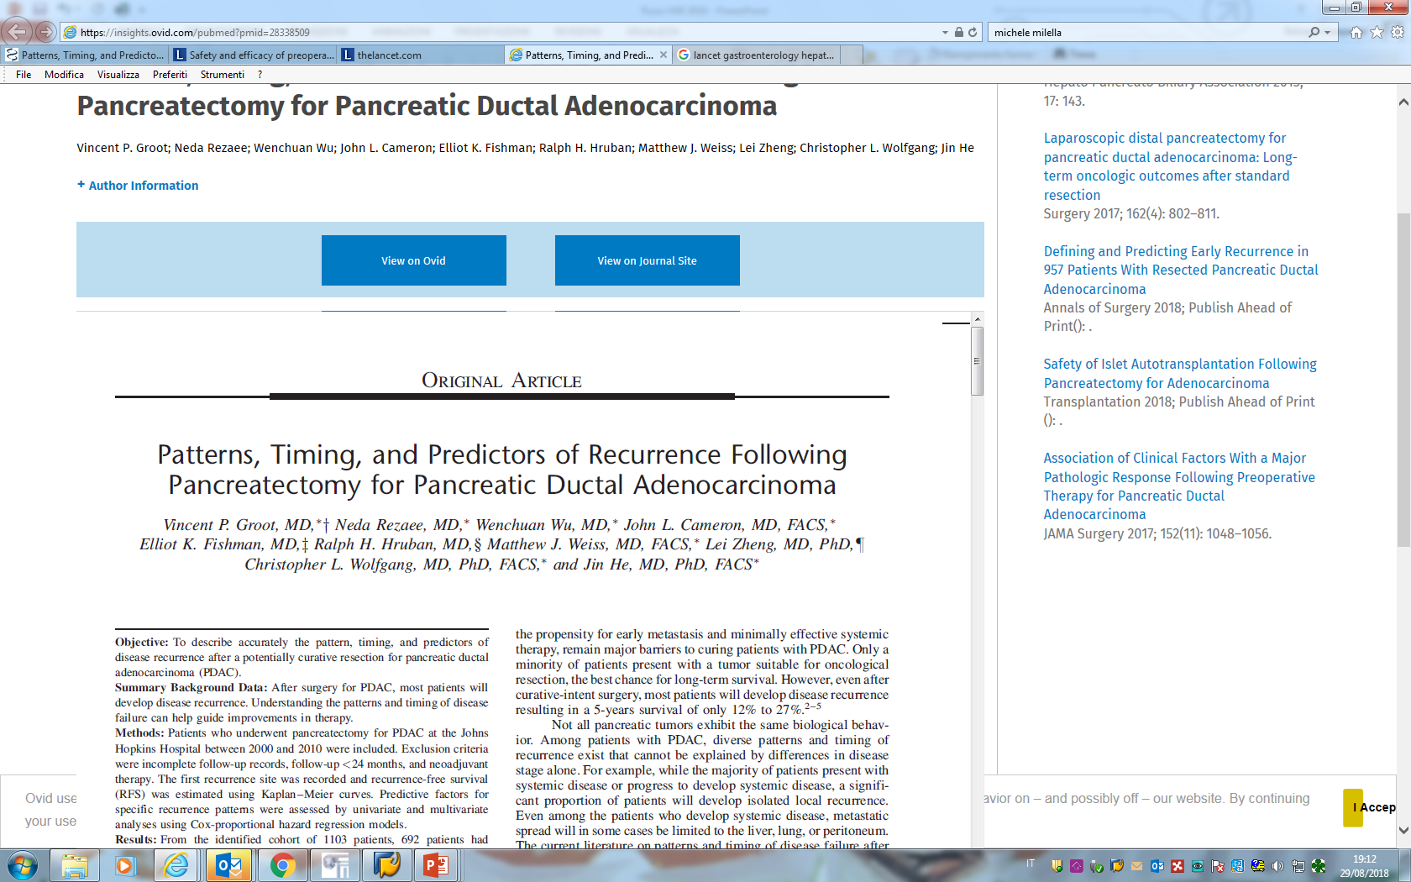
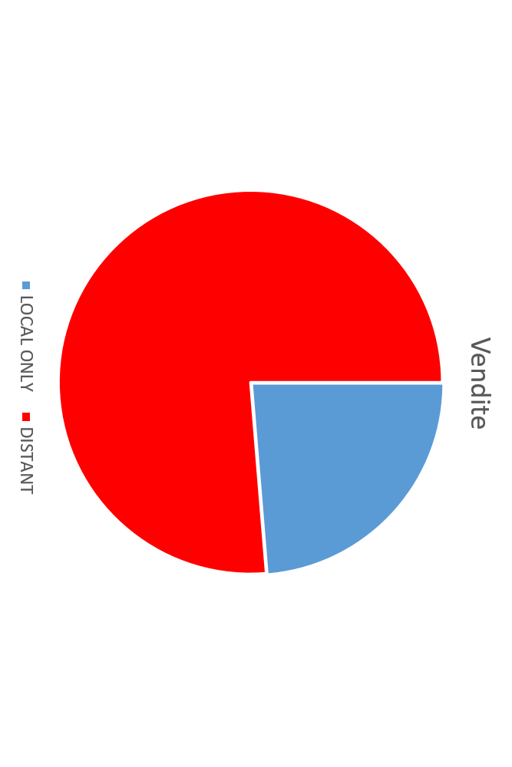
STORIA NATURALE DOPO LA RESEZIONE CHIRURGICA:
LE RECIDIVE SONO SOPRATTUTTO A DISTANZA
SEDE DELLA RECIDIVA DOPO RESEZIONE
Patients who underwent pancreatectomy for PDAC at the Johns Hopkins Hospital between 2000 and 2010 were included.
692 patients had comprehensive and detailed follow-up data available
At a median follow up of 25.3 months, 76.3 % had recurred after a median RFS of 11.7 months
METASTASI
76.3%
SOLO RECIDIVA LOCALE
23.7%
Cortesia di GianPaolo Balzano
Notes:
21

Slide 22
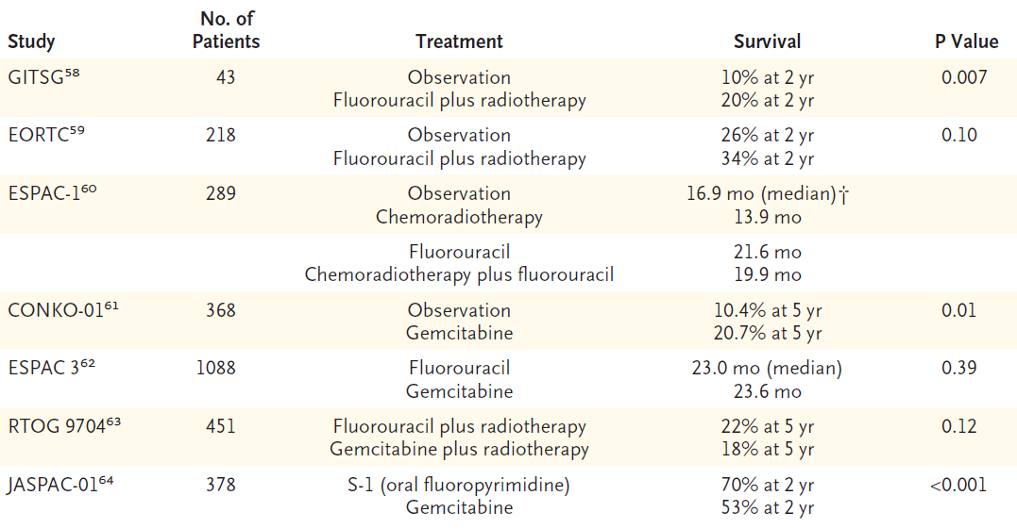
The role of Adjuvant therapy
Ryan D et al., N Engl J Med 2014;371:1039-49

Slide 23
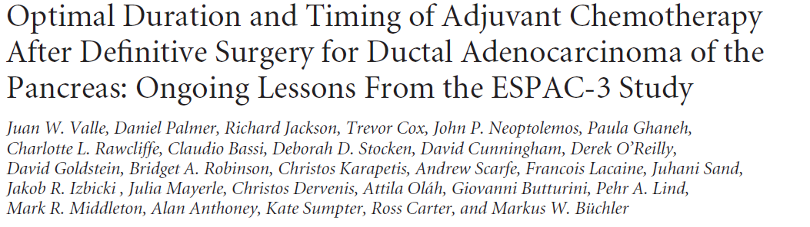
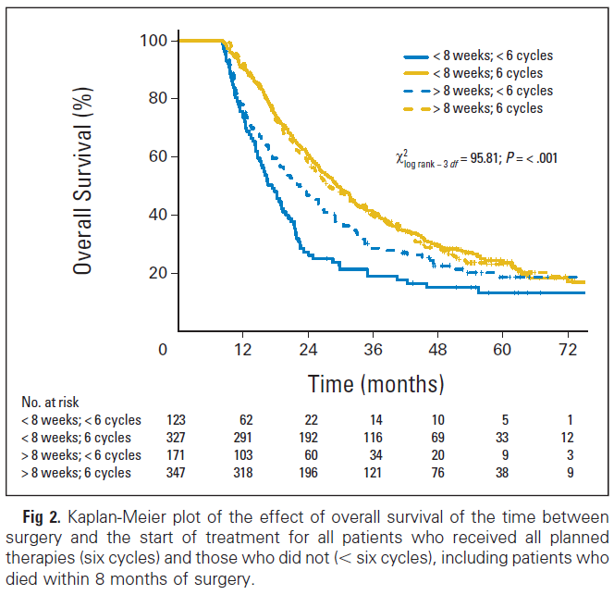
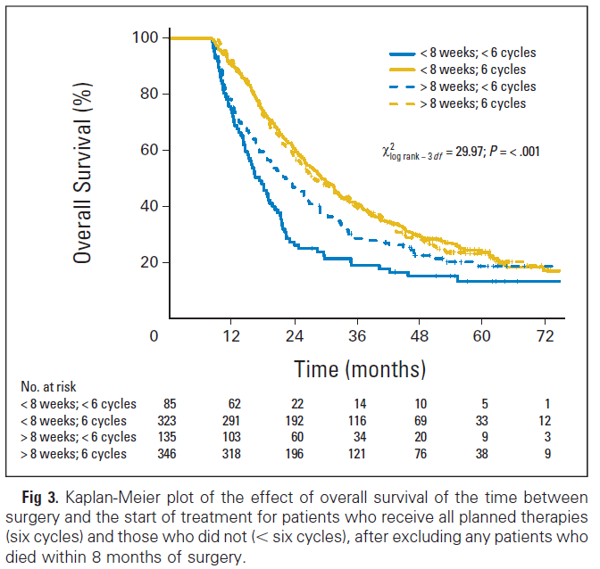
Completion of all 6 cycles of planned adjuvant chemotherapy rather than early initiation was an
independent prognostic factor after resection for pancreatic adenocarcinoma. No difference in outcome if chemotherapy is delayed up to 12 weeks, thus allowing adequate time for postoperative recovery.
Kaplan-Meier plot of the effect on overall survival of the time between surgery and the start of treatment for all patients who received all planned therapies (6 cycles) and those who did not ( 6 cycles), including or excluding patients who died within 8 months of surgery.
including
excluding
Valle J et al. J Clin Oncol 32:504-512, 2014

Slide 24
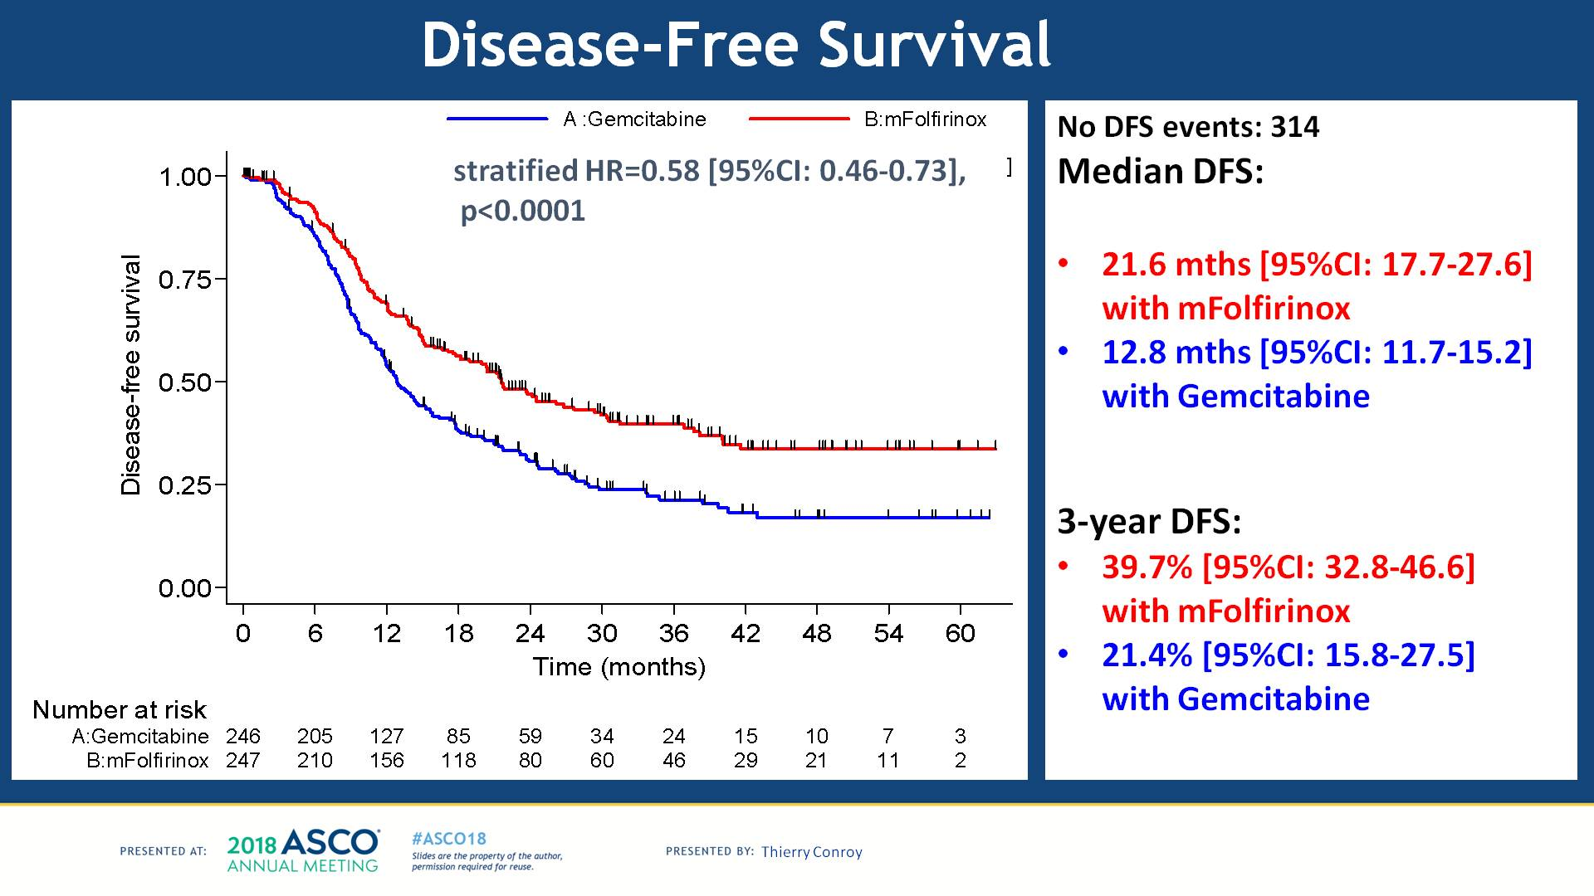
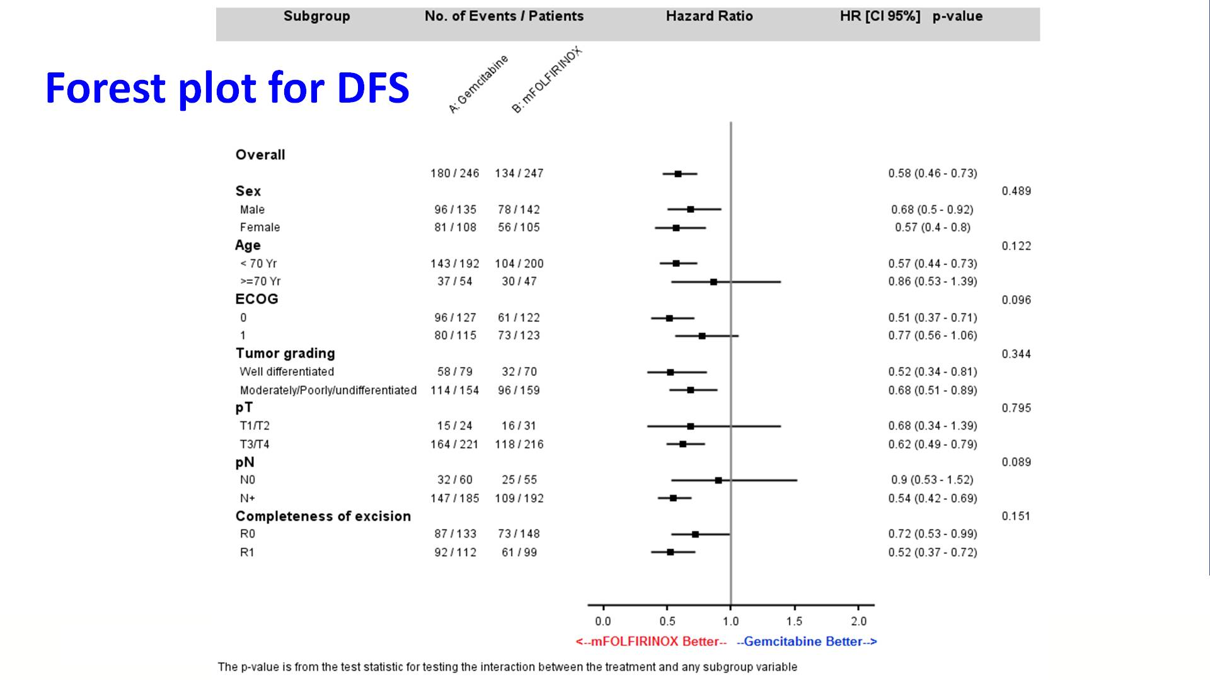
Disease-Free Survival
Prodige 24: Disease free survival
Conroy T, ASCO 2018

Slide 25
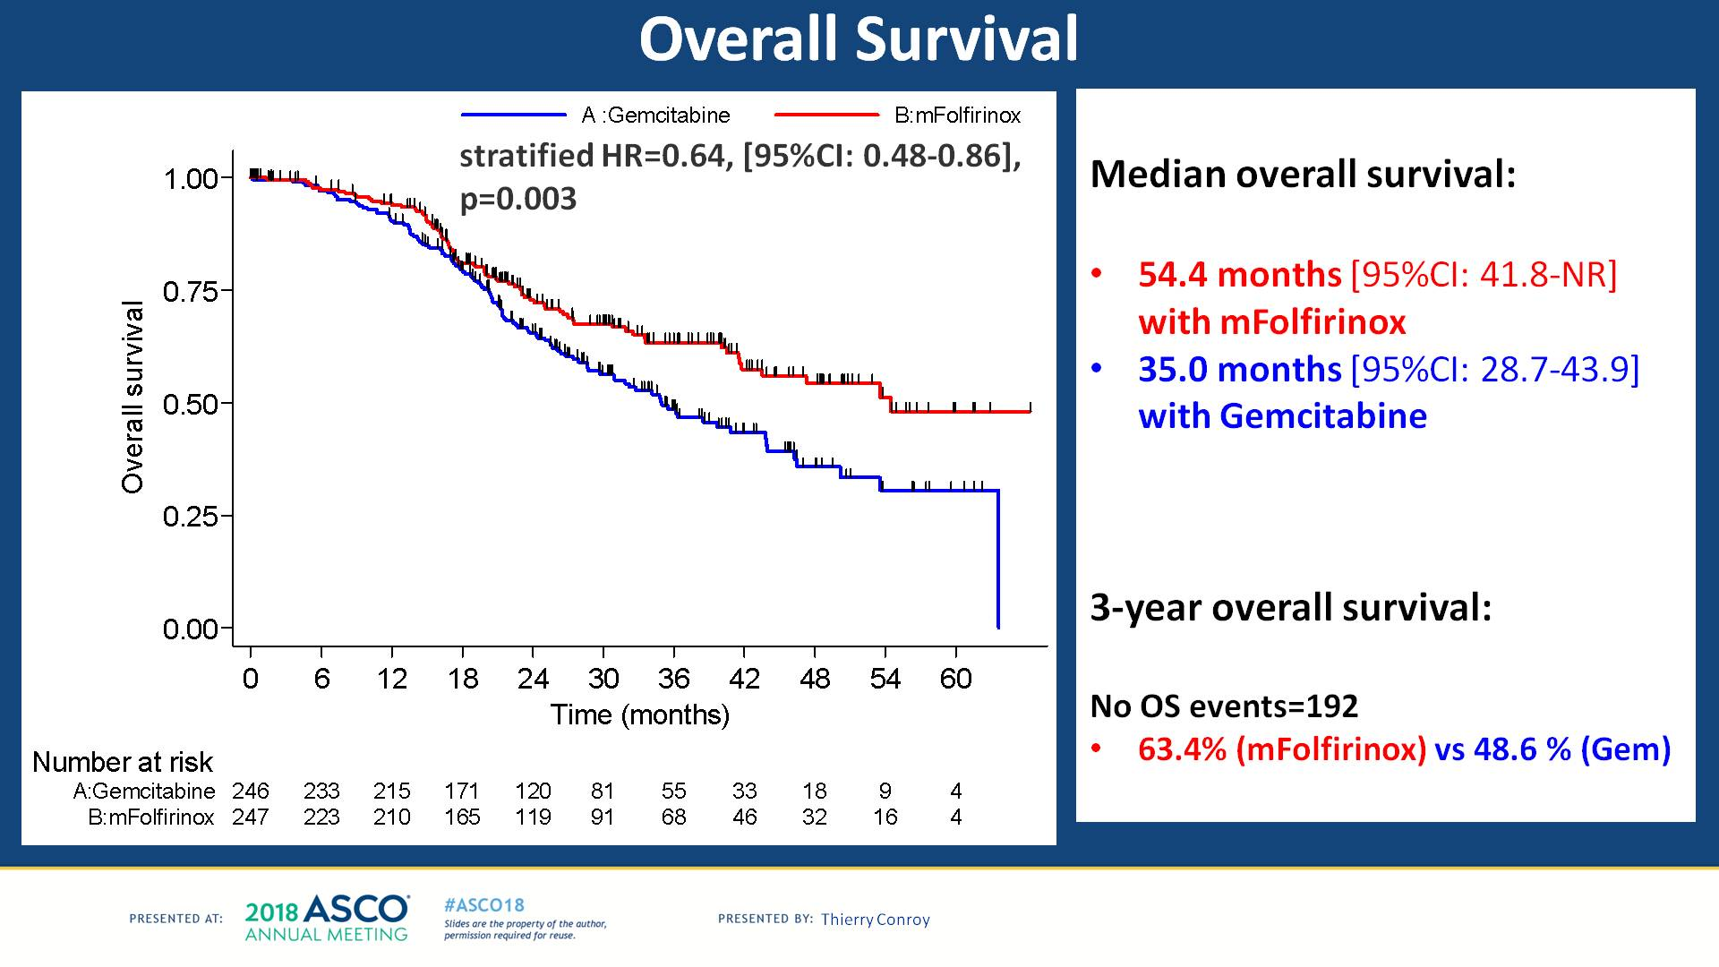
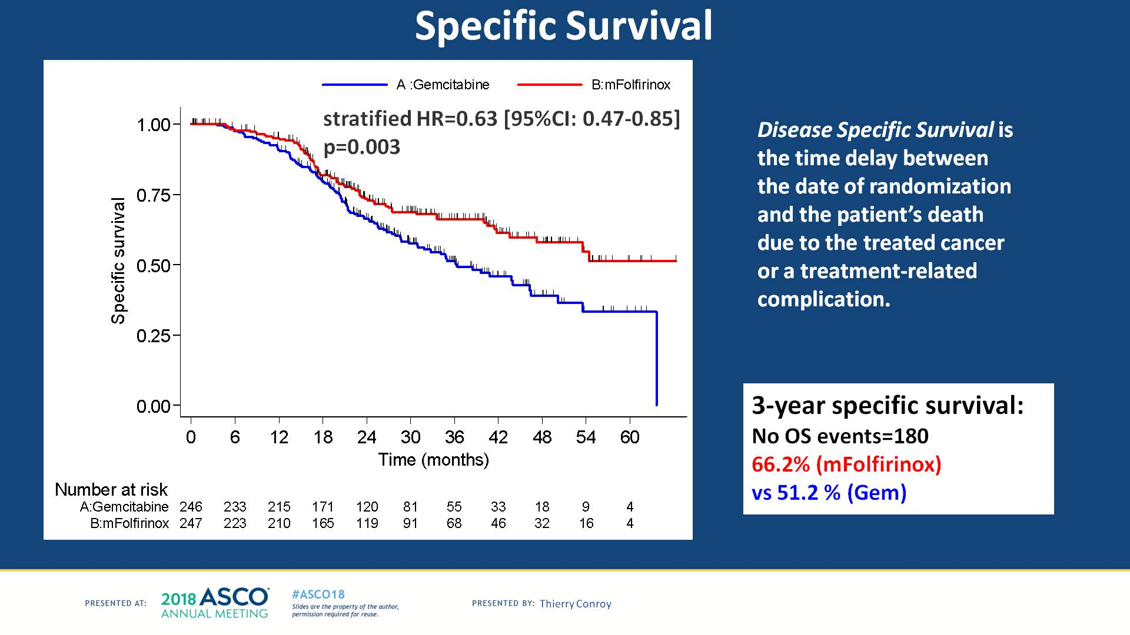
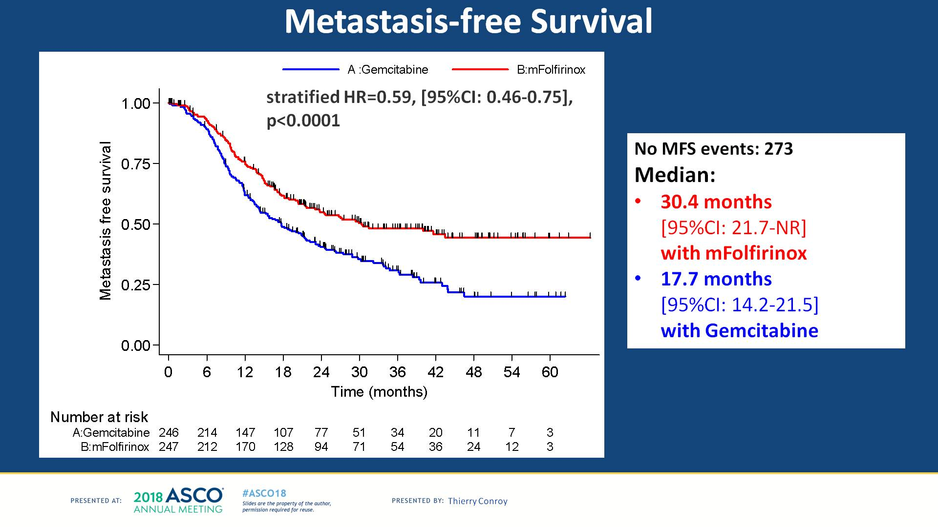
OS, Specific Survival and Metastasis free survival
OS
Specific survival
Metastasis free survival
Conroy T, ASCO 2018

Slide 26
Neoadjuvant
Notes:
26

Slide 27

Neoadjuvant chemotherapy
Pro
Almost 100% of patients can be treated (they are healthier pts)
Treatment of microM1 disease, improvement of local control and, possibly, disease downstaging may allow for a surgical resection in selected cases.
May shrink tumors to improve surgical margins and increase the chance for R0
Reduce operative difficulty and % of pancreas removed
Abundant tissue for correlative studies
Contra
Up to 20% of patients progress during neoadjuvant treatment (local and distant), thus missing patients potentially curable with surgery upfront
Grade 3/4 toxicity higher with neoadjuvant vs adjuvant therapy (8.4%-22%)
More intense protocols (FOLFIRINOX) will have higher toxicity.
Patients are selected, as some patients never make it to surgery.

Slide 28
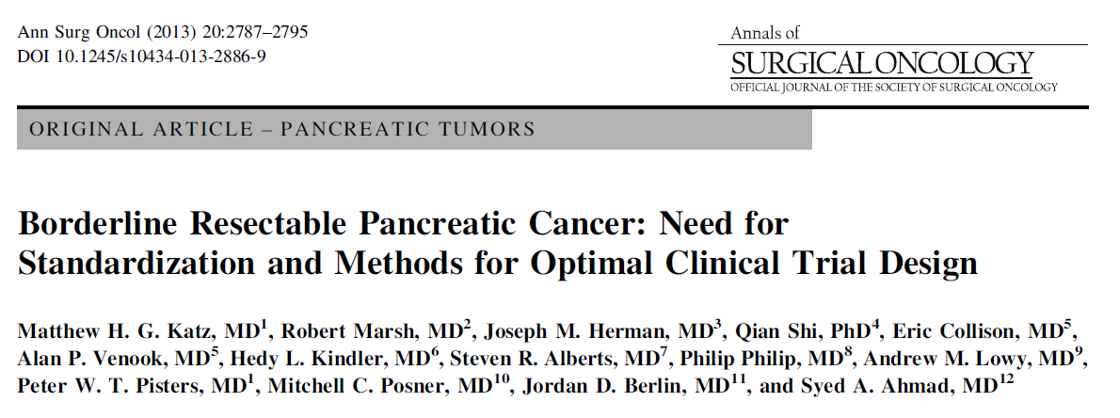
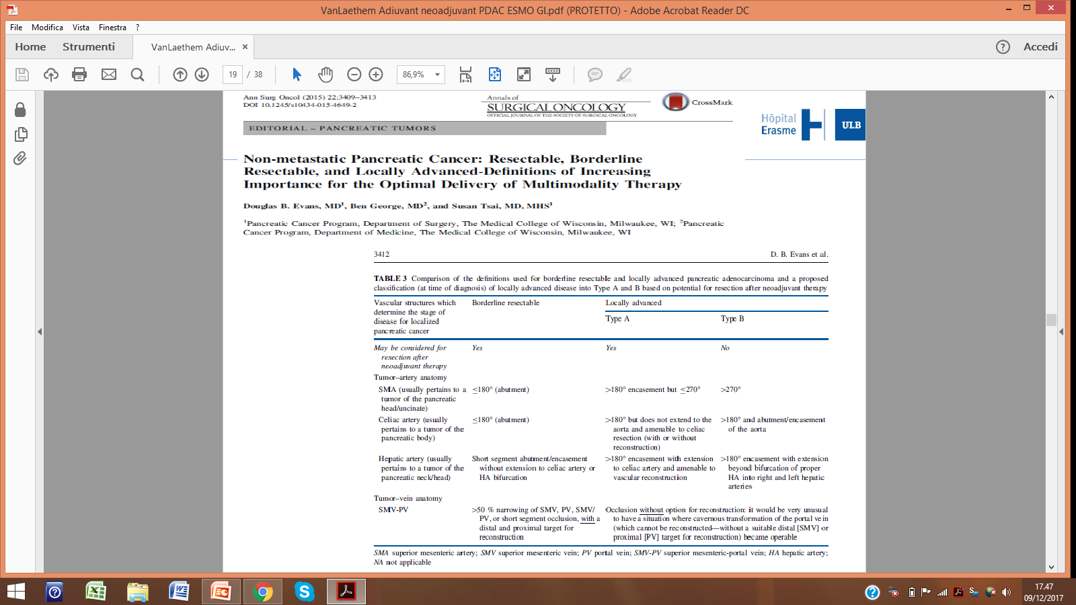
La definizione è importante

Slide 29
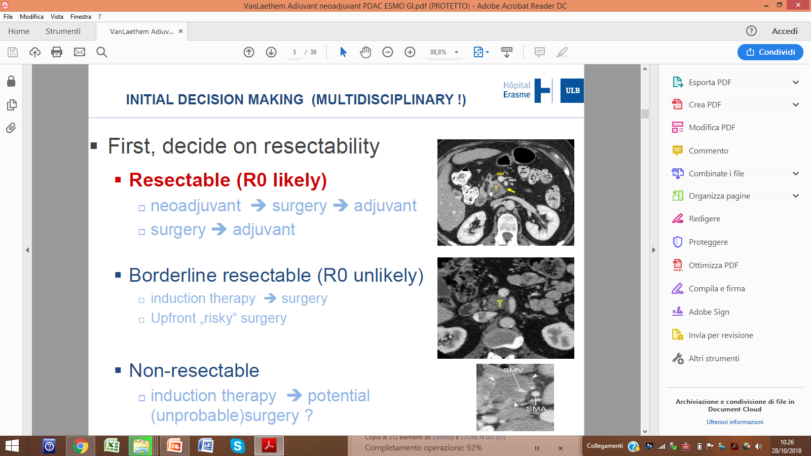
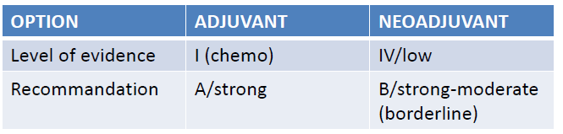
First decide on resectability
Modified from original Van Laethem, WGIC ESMO 2017
In caso di contatto arterioso (di qualsiasi entità), e in caso di irregolarità del profilo venoso,
il paziente va indirizzato a terapia neoadiuvante
GianPaolo Balzano

Slide 30
Resectable

Slide 31
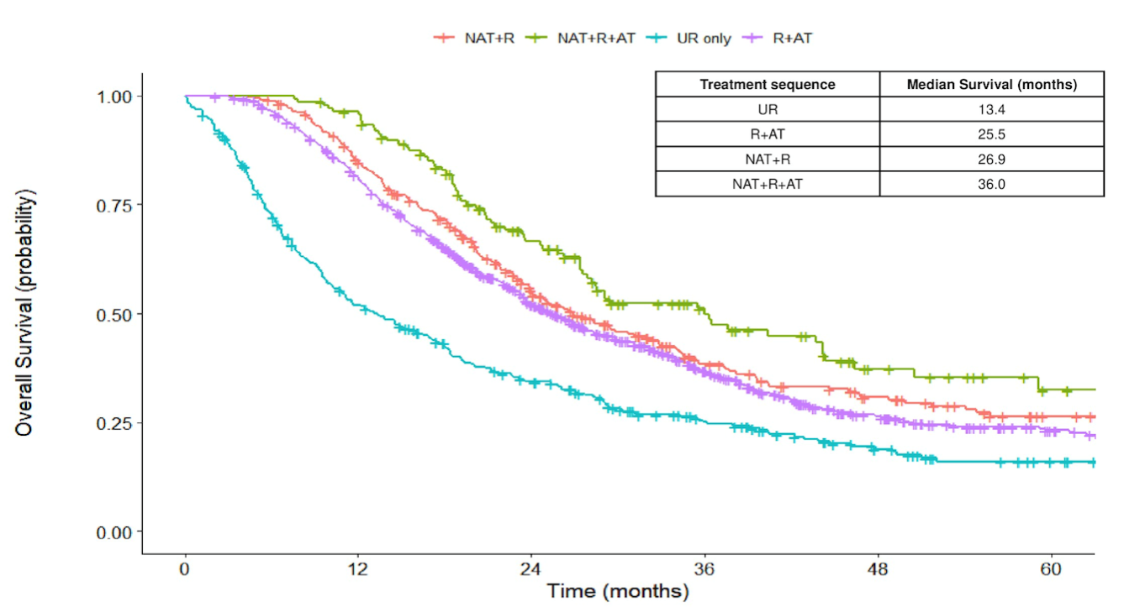
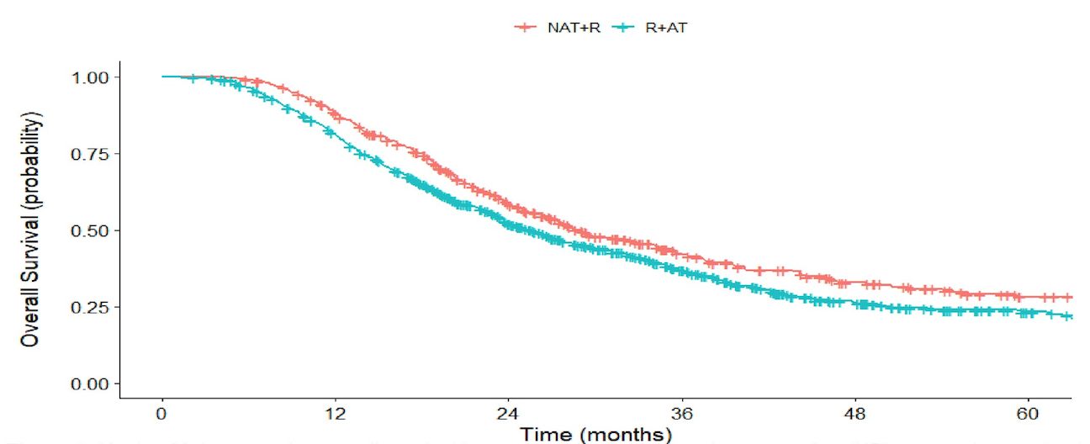
Stage I-II PDCA: Surgery vs Neoadjuvant vs Adjuvant
Ivanics et al. ASCO GI 2019 #450

Slide 32
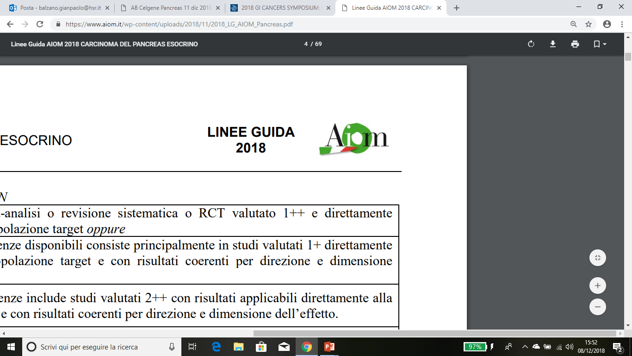
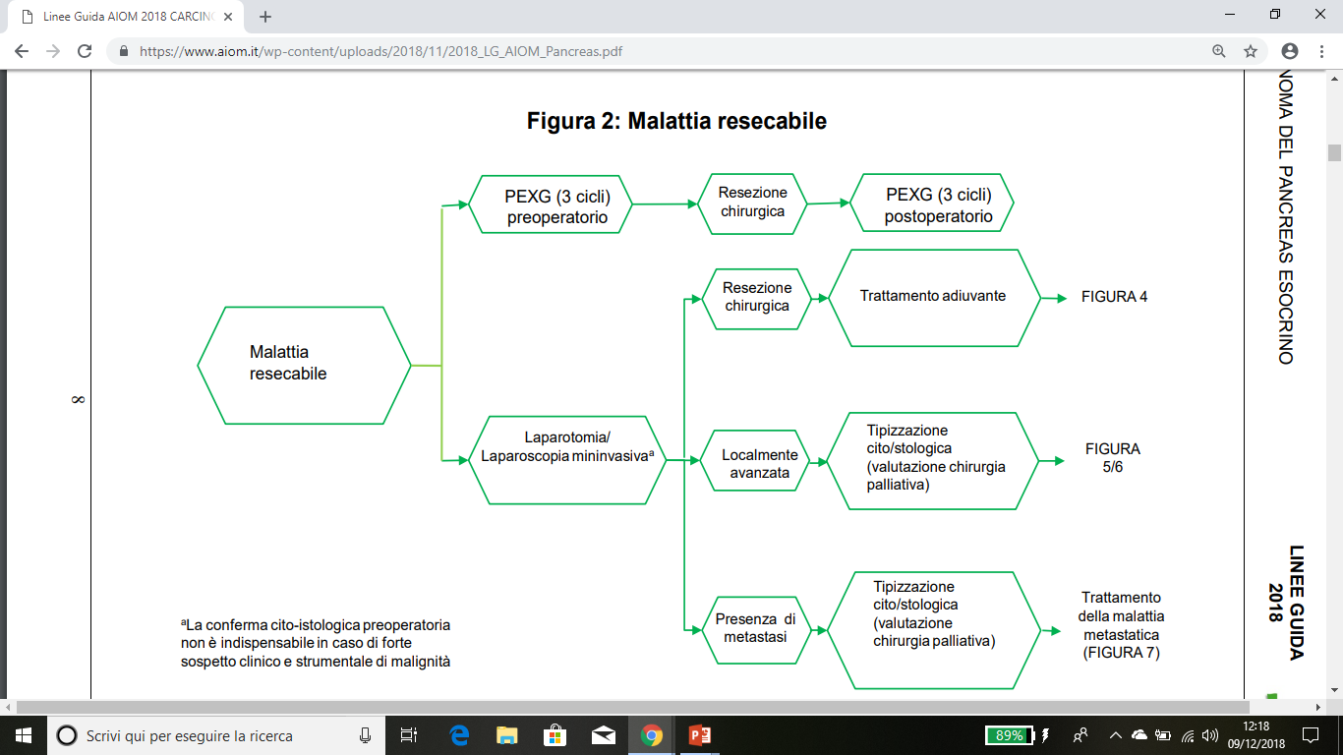
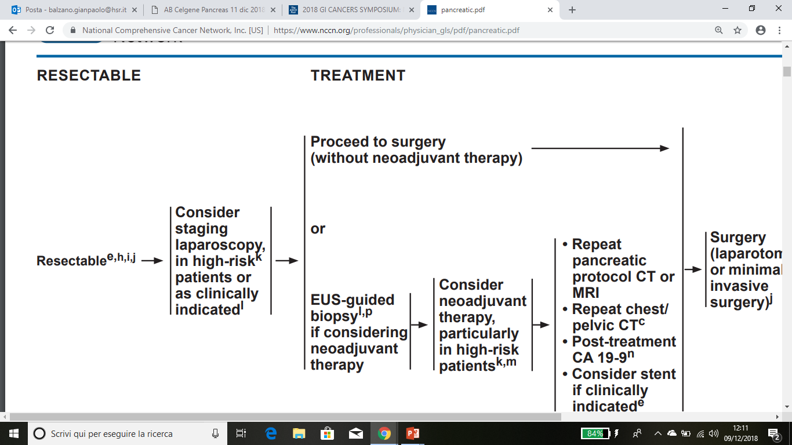
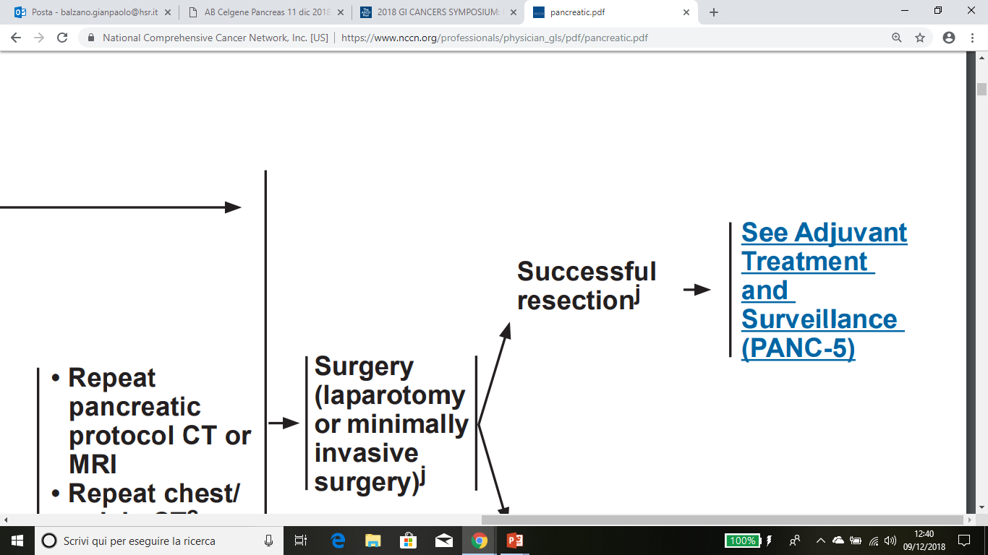
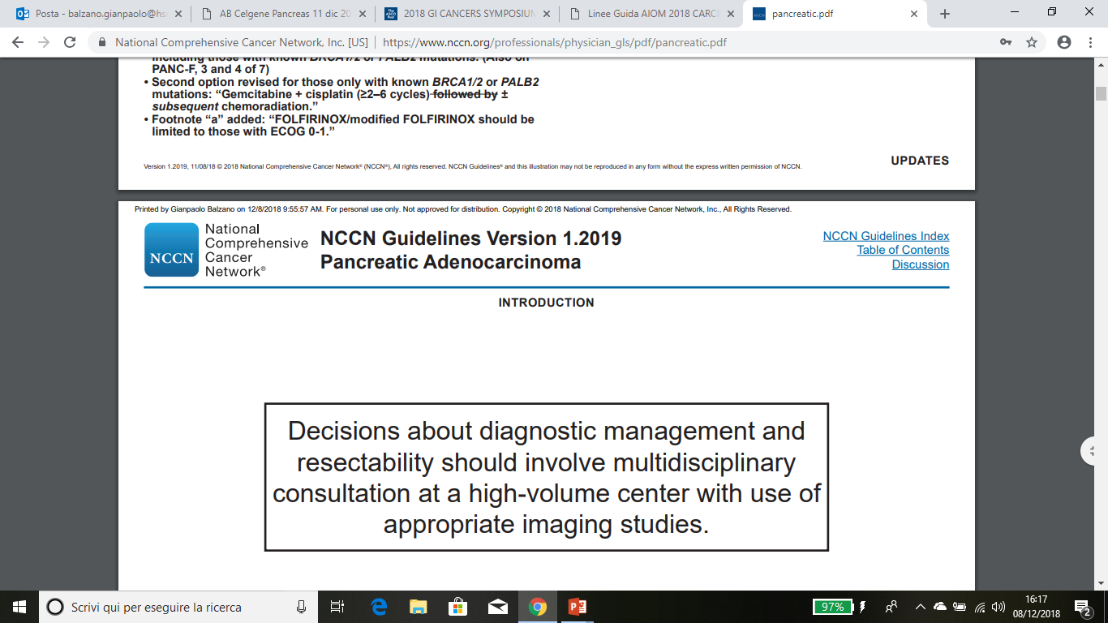
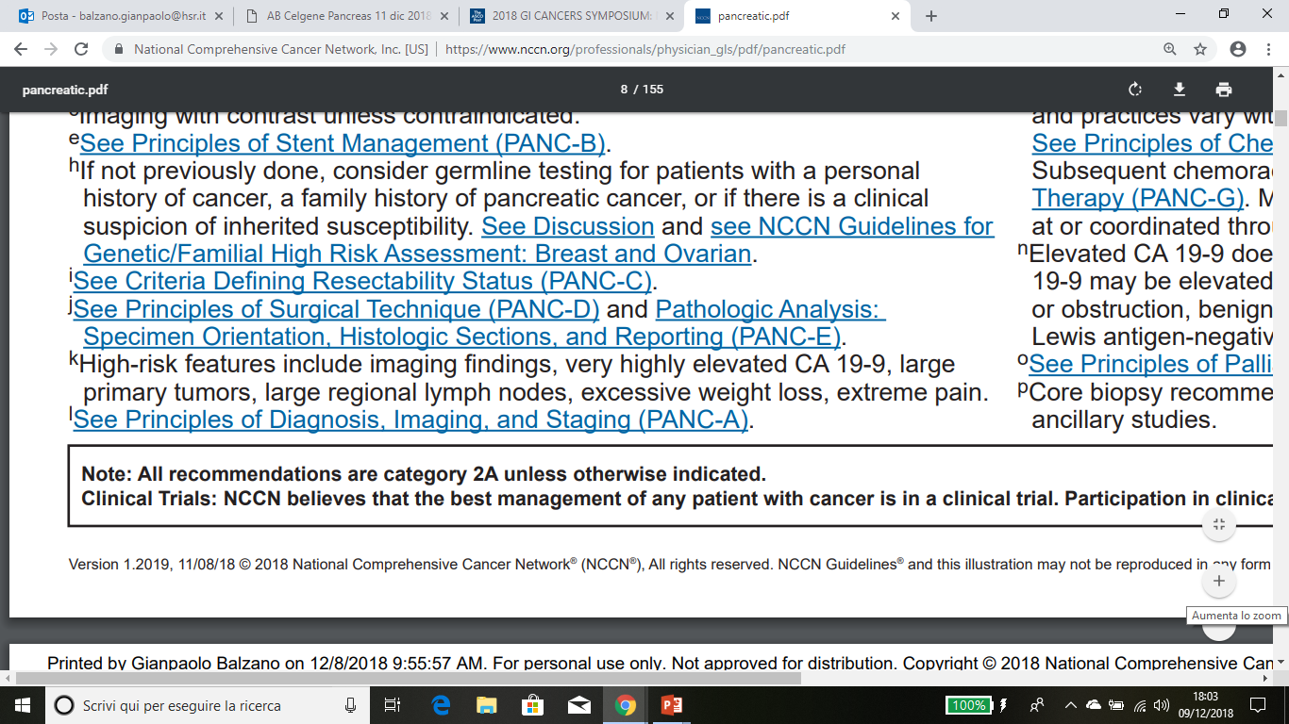
Nuove linee guida AIOM e NCCN prendono in considerazione anche la terapia Neoadiuvante nel PDAC Resecabile

Slide 33
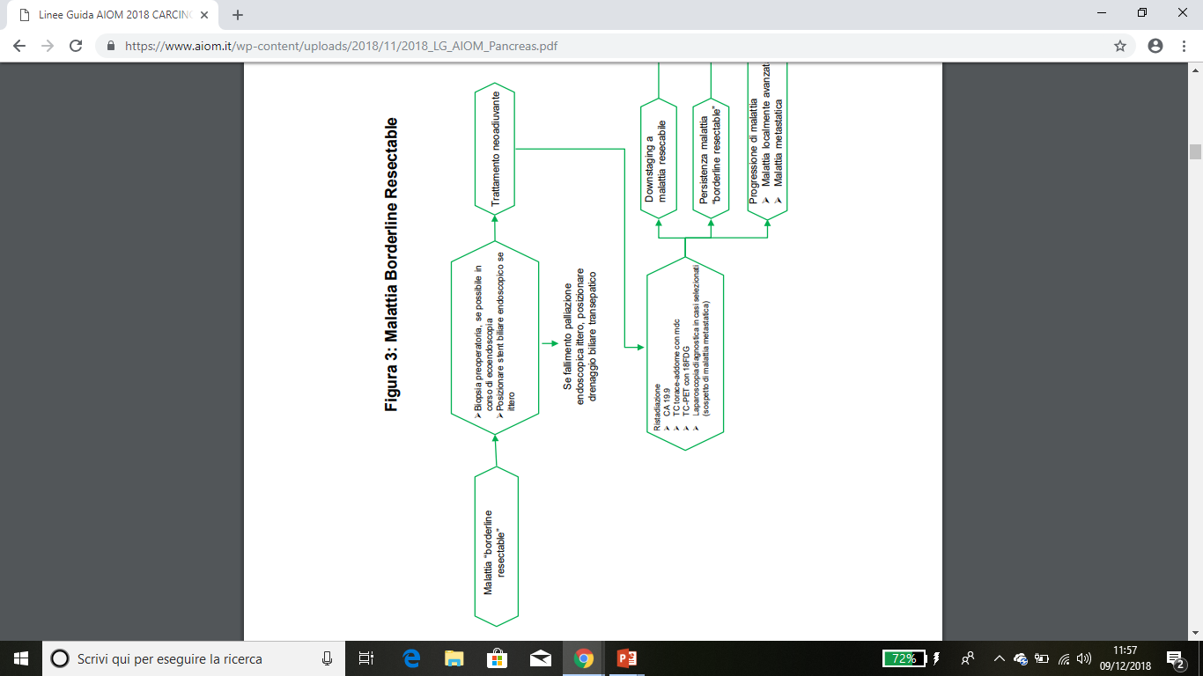
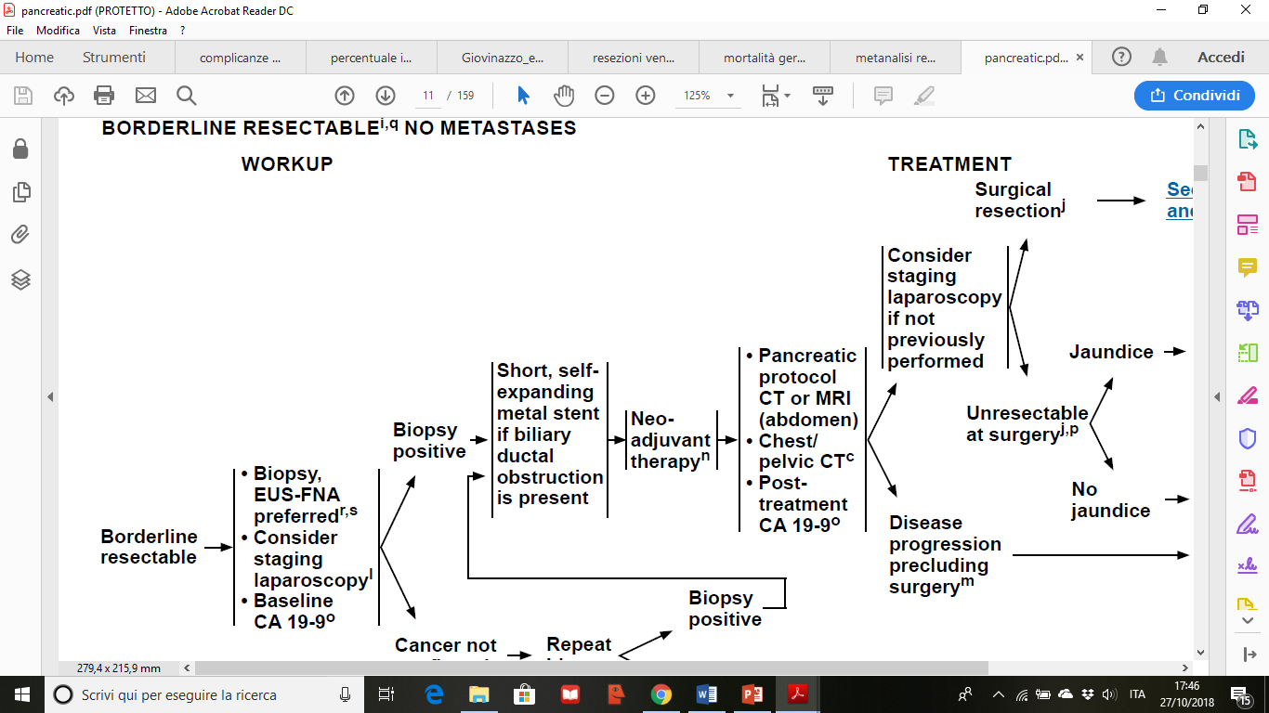
Nuove linee guida AIOM e NCCN consigliano terapia Neoadiuvante nel Borderline Resectable

Slide 34
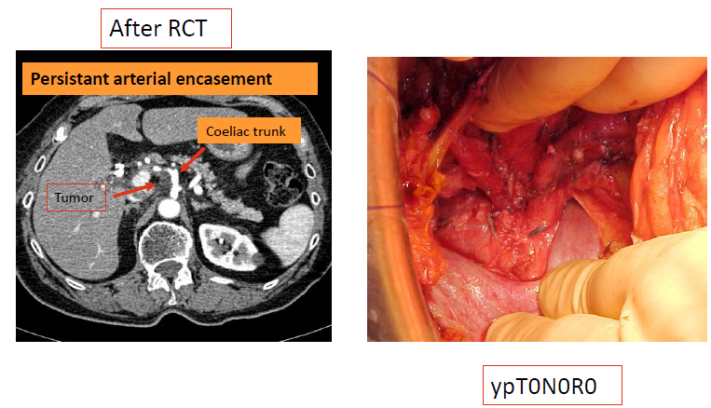
Neoadjuvant CT-RT: imaging is sometimes misleading for reevaluation
A Sa Cunha

Slide 35
Linee guida NCCN 2016
Nuove conoscenze sulla genomica e i profili molecolari dei PDAC

Slide 36
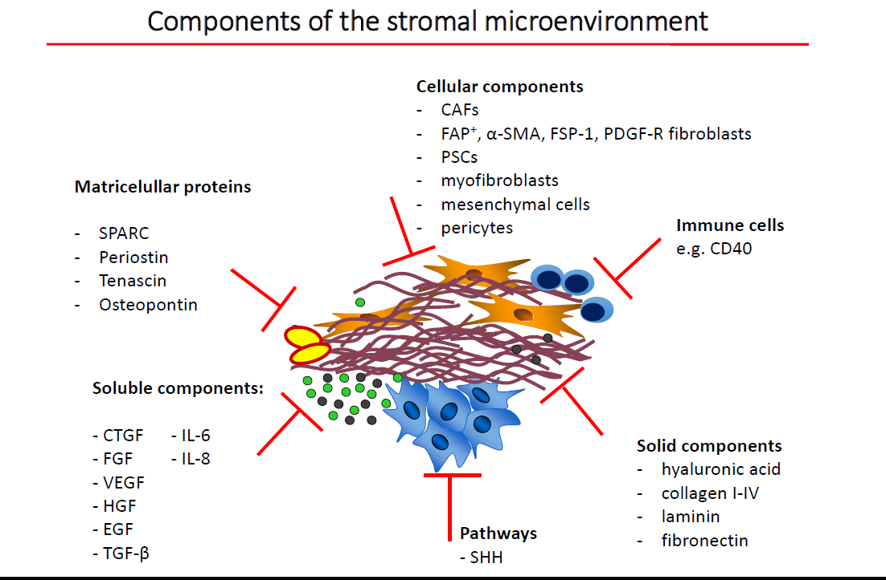
Albrech Nesse, Univ Goettingen

Slide 37
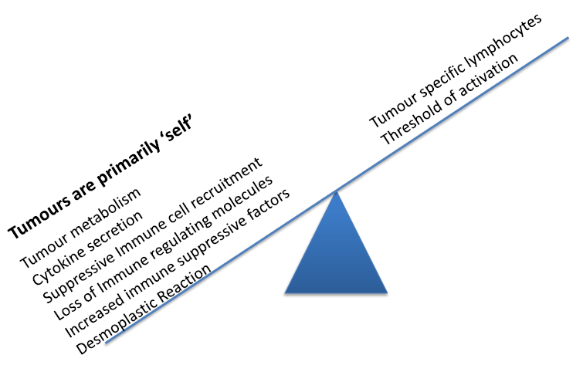

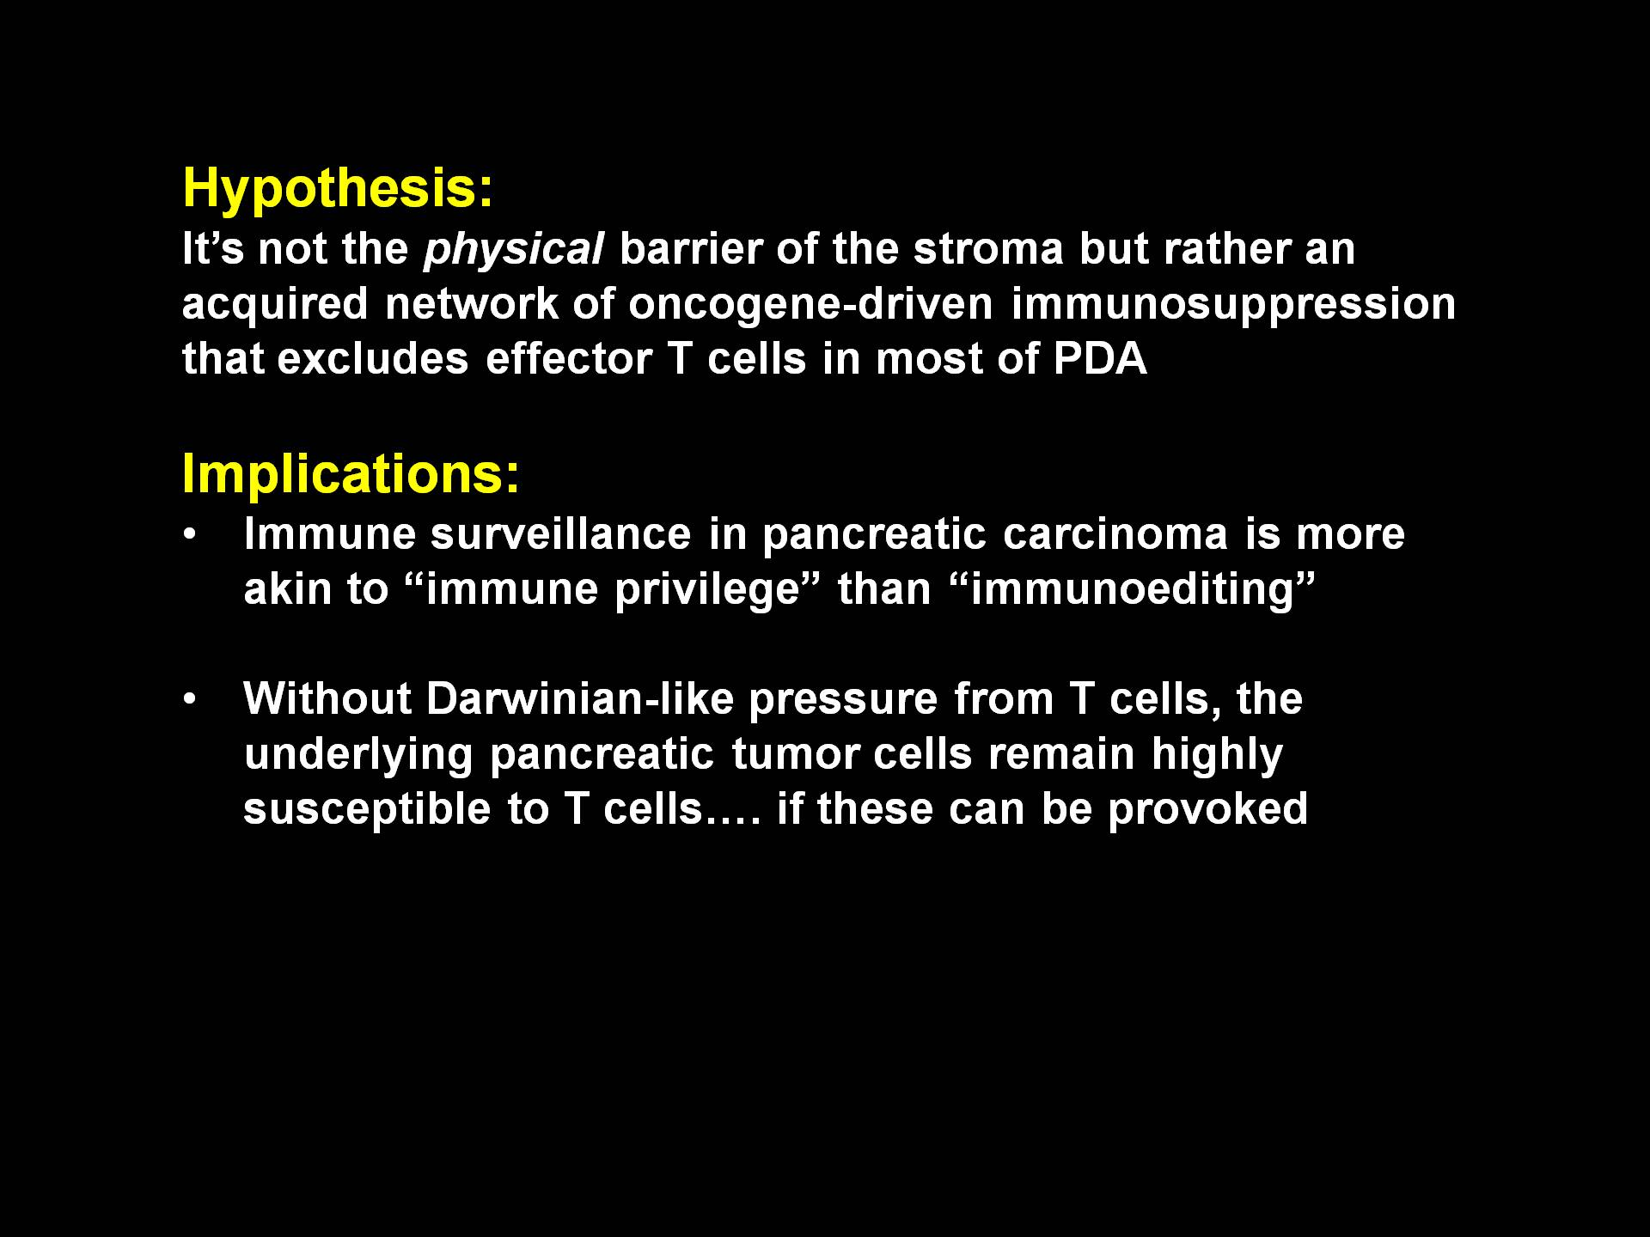
Tumor suppression and Imbalancement of immune response
A strongly immune resistant and suppressive environment
Immune activation
Desmoplastic reaction: myofibroblasts, pancreatic Stellate cells, Treg, MDSC, etc.
Immune Suppression
Mace TA et al., Oncoimmunology. 2013 2:e24891; Vonderheide and Bayne, Curr Opinions in Immunology, 2013
Notes:
37

Slide 38
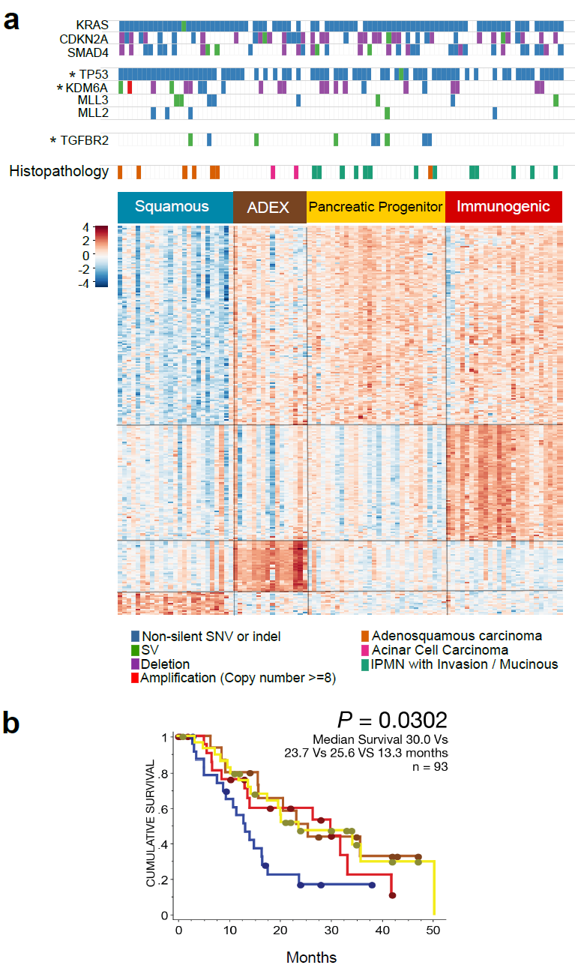
Molecular classes and transcriptional networks of PDAC
Unsupervised analysis of RNAseq identified :
Squamous
ADEX (Abnormally Differentiated Endocrine eXocrine)
Pancreatic progenitor
Immunogenic
4 classes based on transcription factors and downstream targets. Enriched with specific histological features
Bailey P et al Nature March 2016
Notes:
Molecular classes and transcriptional networks defining PDAC.a, Unsupervised analysis of RNAseq identified 4 PDAC classes, designated: Squamous (blue); ADEX (Abnormally Differentiated Endocrine eXocrine; brown); Pancreatic progenitor (yellow); and Immunogenic (red). Clinical data for 97 samples are depicted. An asterix denotes significant enrichment of combined (Non-silent SNV or Indel and SV) mutation calls for the indicated genes

Slide 39
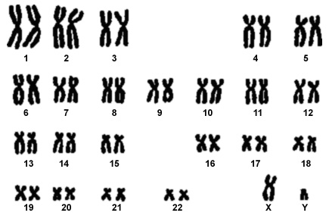
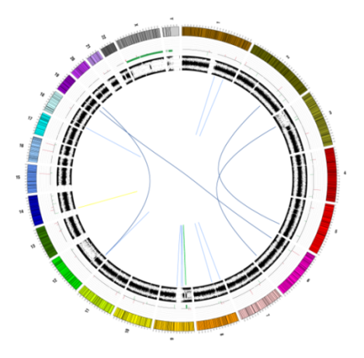




Classifying PDAC by Structural Variation
18%
39%
WGS-KARYOTYPE
Outer rings are chromosomes,
second ring copy-number changes (red equals gain, green equals loss),
the following is allele frequency,
inner lines are chromosome structural rearrangements
Stable
(<50 events)
Scattered
(50 – 200 widespread)
25%
18%
Focal
(50-200, 50% on 1 Chr)
Unstable
(>200 widespread)
Waddell N et al. Nature 518:495-504, 2015

Slide 40

Defects in DNA Damage Repair (DDR) and drug response
DDR-deficient subtype by :
gene mutations
mutational signatures
genomic instability
Unstable Genotype is associated with BRCA signature
Unstable genome and BRCA pathway mutations may predict response to platinum
Waddell N et al. Nature 518:495-504, 2015

Slide 41

Responses to platinum therapy
Waddell N et al. Nature 518:495-504, 2015
Notes:
a, ICGC_0006: one of two patients who had an exceptional response to platinum-based therapy. Treatment of the recurrence with FOLFOX resulted in an exceptional response
with recanalization of the portal vein which was previously obliterated by tumour and resolution of the mass with complete normalization of CA19.9 levels. b, Platinum responsiveness in patient-derived xenografts. Curves represent relative tumour volume (0.5 3 length 3 width2, y axis) over time (days, x axis). Arrows indicate drug treatment. Responses remain stable for .210 days. Error bars indicate standard error of the mean.

Slide 42


Metastatic pancreatic cancer
Standard-of-care FOLFIRINOX or gemcitabine + nab-paclitaxel^{1,2}
Median PFS ~6 months^{1,2}
Median OS 8–12 months^{1,2}
<50% of patients receive 2nd-line treatment³
No targeted treatments for a biomarker-selected population validated by Phase III trial
Maintenance treatments aim to prolong tumour control following chemotherapy
4–7% harbor a germline BRCA1 and/or BRCA2 mutation (gBRCAm)^{4,5}
Increased benefit from platinum-based chemotherapy^{6,7}
1. Conroy T et al. N Engl J Med 2011;364:1817–1825; 2. Von Hoff DD et al. N Engl J Med 2013;369:1691–1703; 3. Hidalgo M et al. Pancreatology 2015;15:8–18;
4. Friedenson B et al. MedGenMed 2005;7:60; 5. Golan T et al. J Clin Oncol 2018;36:4115; 6. Waddell N et al. Nature 2015;518:495–501; 7. Golan T et al. Br J Cancer 2014;111:1132–1138
Hedy L Kindler

Slide 43
Rationale for PARP inhibition in BRCA-deficient tumors
Method of action
Clinical evidence
Olaparib traps PARP
at sites of DNA
single-strand breaks
Accumulation of DNA double-strand breaks
 | Phase II olaparib trial (N=298)
Patient population | n=23 gBRCAm Prior gemcitabine for advanced PC 1–8 prior lines of therapy
Median PFS | 4.6 months
ORR | 21.7%
HRR-deficient cancer cell,
eg gBRCAm
Normal cell
Reliance on error-prone pathways
Homologous recombination repair
Cell death
Cell survival
1. O’Connor M et al. Mol Cell 2015;60:547–560; 2. Kaufman B et al. J Clin Oncol 2015;33:244–250
Hedy L Kindler

Slide 44


POLO Study design
≥16 weeks
4–8 weeks
Follow-up
First-line chemotherapy
Randomization
Maintenance treatment
Discontinuation
Key eligibility criteria
Metastatic pancreatic cancer
Deleterious or suspected deleterious germline BRCA1
or BRCA2 mutation
≥16 weeks first-line platinum-based chemotherapy, without progression (CR, PR or SD)*
Maintenance olaparib tablets 300 mg bid
Randomized 3:2
No stratification factors
Until investigator-assessed disease progression or unacceptable toxicity
or
Placebo
38% of gBRCAm patients had disease progression, were ineligible, or declined randomization
*There was no maximum limit to the duration of first-line chemotherapy. bid, twice daily; CR, complete response; PR, partial response; SD, stable disease
Hedy L Kindler

Slide 45
Primary endpoint: PFS by blinded independent
central review*
 | Olaparib (N=92) | Placebo (N=62)
Median PFS, months | 7.4 | 3.8
 | HR 0.53
 | 95% CI 0.35, 0.82; P=0.0038
1.0
0.9
0.8
0.7
0.6
Probability of PFS
Progression-free at data cut-off:†
30 olaparib patients (32.6%)
12 placebo patients (19.4%)
0.5
0.4
0.3
0.2
Olaparib
0.1
Placebo
0.0
0
2
4
6
8
10
12
14
16
18
20
22
24
26
28
30
32
34
36
38
40
42
44
46
48
50
No. at risk
Time since randomization (months)
92
69
50
41
34
24
18
17
14
10
10
8
8
7
5
3
3
3
3
2
1
1
1
0
Olaparib
62
39
23
10
6
6
4
4
4
2
2
2
2
1
1
0
Placebo
*Dots indicate censorship. †15 January 2019. CI, confidence interval
45

Slide 46
Primary endpoint: PFS by blinded independent central review
60
From 6 months onwards, more the twice the proportion of olaparib-arm patients were progression-free
50
53%
40
Patients free from disease progression or death, %
34%
30
28%
23%
22%
20
15%
10%
10%
10
0
0
6
12
18
24
Time since randomization (months)
Hedy L Kindler

Slide 47
PFS2 by investigator assessment, 46% maturity*
1.0
 | Olaparib (N=92) | Placebo (N=62)
Median PFS2, months | 13.2 | 9.2
 | HR 0.76
 | 95% CI 0.46, 1.23; P=0.26
0.9
0.8
0.7
0.6
Probability of PFS2
0.5
0.4
Olaparib
Time to second progression may indicate durability of treatment benefit
0.3
0.2
Placebo
0.1
0.0
0
2
4
6
8
10
12
14
16
18
20
22
24
26
28
30
32
34
36
38
40
42
44
46
48
50
No. at risk
Time since randomization (months)
Olaparib
92
82
65
56
43
32
27
22
19
13
12
11
8
7
5
4
3
3
3
2
1
1
1
0
*Dots indicate censorship. PFS2, time to second progression
Placebo
62
54
43
36
24
17
12
7
5
4
4
4
3
2
2
1
0
Hedy L Kindler

Slide 48
Objective response rate in patients with measurable disease by blinded independent central review
23.1%
Olaparib
5.4 months
Placebo
3.6 months
11.5%
Median time to onset of response
n=18
n=6
Olaparib
24.9 months
Olaparib
N=78
Placebo
N=52
Placebo
3.7 months
2 olaparib arm pts. had a complete response
Both CR were ongoing at the data cut-off
Median duration of response
Hedy L Kindler

Slide 49

Significantly mutated genes in the DDR pathway and therapeutic opportunities
Taking into account germline and somatic mutations in
well-defined DDR genes, unstable genomes and the BRCA mutational signature, DDR deficiency prevalence increases up to 24%
Dreyer S.B. et al. Clin Cancer Res; 23:1638-46, 2017

Slide 50

Tumor microenvironment, signalling pathways and
novel therapies
Krantz.. ,O’ Reilly, Chin Clin Oncol 2017;6(3):30
Notes:
Targeted cellular compartments plotted in this figure include pancreatic cancer cells, CSCs, and the immunosuppressive stroma. Novel cytotoxics such as nab-paclitaxel (albumin-bound paclitaxel), TH‑302 (which is activated to release the alkylating agent Br-IDM in the hypoxic tumour microenvironment) and MM‑398 (a liposomal formulation of irinotecan) target pancreatic cancer cells. Various SMO, Notch and Wnt/β-catenin inhibitors have been developed to target key CSC pathways. PEGPH20, a PEGylated form of a recombinant human hyaluronidase, targets the tumour stroma. In addition, different strategies are being pursued to modify the immunosuppressive environment in PDAC and overcome immune evasion by tumour cells. IDO is an enzyme involved in tryptophan metabolism leading to preferential differentiation of T cells to regulatory T cells. In addition depletion of tryptophan is toxic for effector T cells. Thus, IDO inhibitors lead to increased effector T‑cell numbers and a decrease in regulatory T‑cell populations, thereby promoting immune surveillance. CXCL12, the ligand for CXCR4, is produced by CAFs; CXCL12 binds to its receptor in the membrane of T cells, which is hypothesized to result in apoptosis or chemorepulsive effects in the T cells. Indeed, in a KPC mouse model, CXCR4 antagonists induced accumulation of effector T cells within tumours and had a synergistic antitumour effect with immune-checkpoint inhibitors targeting PD‑1 and PD‑L1. Ongoing early phase clinical trials are testing CXCR4 plus PD‑1 or PD‑L1 inhibitors in PDAC. In addition, promising data have been obtained with the antitumour vaccine GVAX pancreas (allogeneic pancreatic cancer cells modified to express GM‑CSF), together with CRS‑207 (live-attenuated Listeria monocytogenes expressing mesothelin). Adoptive transfer of CAR T cell also holds promise in the treatment of PDAC. Abbreviations: Br-IDM, dibromoisophosphoramide mustard; CAFs, cancer-associated fibroblasts; CAR, chimeric antigen receptor; CSC, cancer stem cell; CXCL12, CXC chemokine ligand 12; CXCR4, CXC chemokine receptor 4; D‑1MT, D‑1-methlytryptophan; DLL, Delta-like ligand; GM‑CSF, granulocyte-macrophage colony-stimulating factor; HGF, hepatocyte growth factor; HH, Hedgehog; IDO, indoleamine 2,3-dioxygenase; PD‑1, programmed cell death protein 1; PDAC, pancreatic ductal adenocarcinoma; PDGF, platelet-derived growth factor; PD‑L1, programmed cell death 1 ligand 1; SMO, smoothened; SPARC, secreted protein acidic and rich in cysteine; VEGF, vascular endothelial growth factor.

