Slide 1

Prevenzione Cardiovascolare Secondaria nella Pratica Clinica
Come controlliamo i principali fattori di Rischio in Italia
Furio Colivicchi
Ospedale S. Filippo Neri, Roma
Presidente Eletto

Slide 2
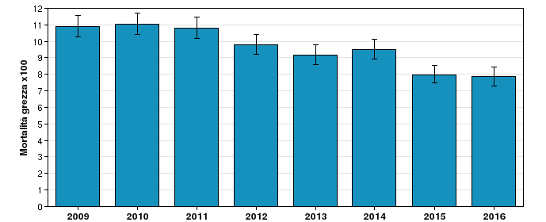
30-day mortality in patients admitted for ACS
Outcome evaluation project PREVALE-PNE from the Lazio region of Italy
http://95.110.213.190/prevale2016/ospedaliera/ospedaliera.php

Slide 3
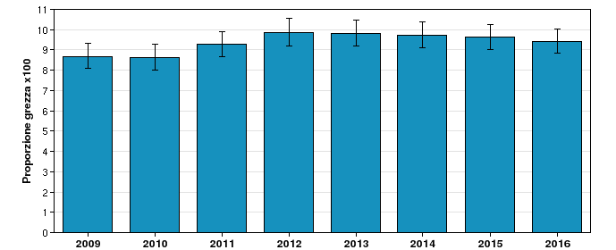
12-month mortality in patients admitted for ACS
Outcome evaluation project PREVALE-PNE from the Lazio region of Italy
http://95.110.213.190/prevale2016/territoriale/territoriale.php

Slide 4
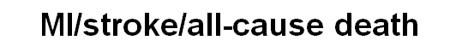
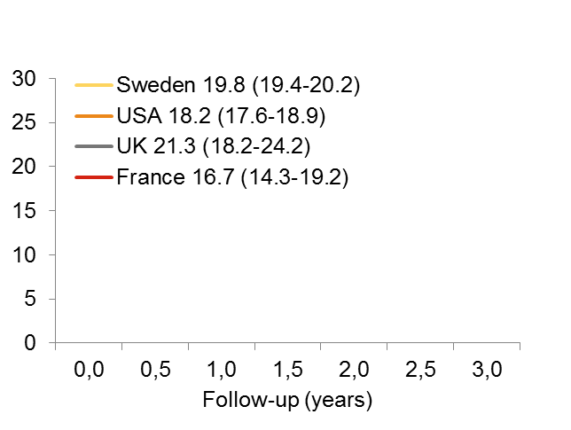

Almost 20% of patients who are event free for the first year post-ACS, will suffer an MI, stroke or death within 3 years
APOLLO 4-country analysis: adjusted incidence*^{[Rapsomaniki 2014]}
MI/stroke/all-cause death
Adjusted risk (%)
Shaded areas correspond to 95% confidence intervals
MI, myocardial infarction.
*Adjusted for differences in study populations; MI, myocardial infarction. Shaded areas / figures in brackets [95%CI]
1. Rapsomaniki E et al. ESC Late Breaking Registry presentation 2014.
Notes:
Background
International comparisons have shown differences in acute and short-term outcomes in MI patients, but many remain at elevated risk beyond this period. Multiple registries derived from electronic health and administrative records offer an innovative approach to understanding which factors have greatest impact on the prognosis of high-risk patients and how this varies across different healthcare systems, with the potential to inform quality improvement initiatives
Objective
To compare the atherothrombotic and bleeding risks in 1-year post-MI survivors across the USA, Sweden, England, and France
Patients and methods
Linked electronic health records and disease registries (England, Sweden) and administrative data (US, France) according to common disease definitions based on admission ICD-10 codes and common analysis protocol were analysed. Eligible patients were those who had survived without further MI for 1 year following hospitalisation for MI in 2002–2011 (N=77,976 [Sweden], 53,909 [US; sample restricted to ≥65 years old patients], 7238 [England] and 1757 [France]). Outcome predictors were identified and used in multivariate CoxPH models to estimate adjusted risks
Outcomes
MI, stroke, cardiovascular (CV) death, all-cause mortality, and hospitalised bleeding
Results
Compared with Swedish and English patients (mean age ~70), French patients were younger (mean age 66) and healthier, whilst US patients were older (minimum age 65; mean age 79) with more comorbidities. Outcome predictors (prevalence range over countries) were age (54–100% aged ≥65), male gender (51–68%), diabetes (21–35%), history of more than one MI (12–19%), stroke (7–0%), heart failure (21–45%), peripheral arterial disease (1–10%), renal disease (3–7%), prior hospitalisation for bleeding (4–17%), atrial fibrillation (14–28%), coronary obstructive pulmonary disorder (8–28%), and cancer (7–12%), all of which had similar strong positive associations with the outcomes in each country. Use of percutaneous coronary intervention (42–62%) or coronary artery bypass grafting (6–17%) in the year post-MI was associated with lower risk across all studies and outcomes. There were large differences in the observed 3-year cumulative risk for the composite of MI, stroke or death across the different countries, ranging from 17.3% (France) to 36.2% (US), and in the 3-year cumulative risk of hospitalised bleeding, ranging from 2.2% (France) to 7.1% (US)
After multiple adjustments risk differences for MI, stroke or death were small, but differences in risk of bleeding remained
Conclusion
Risk of CV events remained high across the 3 years and across the four countries studied. The predictors for identifying 1-year post-MI survivors with increased risk of CV or bleeding events are similar across different countries and partially explain differences in observed risks. This study highlights the importance of comorbidity management in this high risk population and exemplifies the power and generalisability of prognosis research that utilises the clinical records of different countries

Slide 5
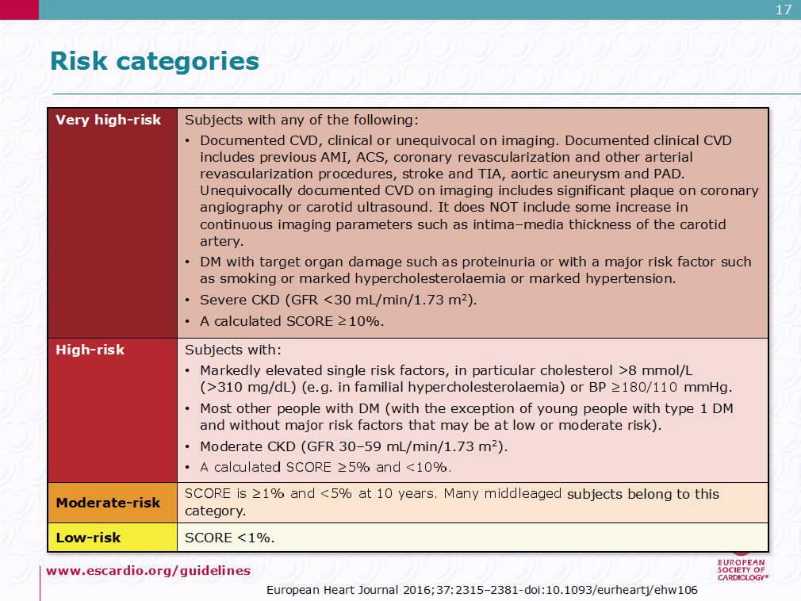

Slide 6
Patient Risk Groups: Risk Phenotypes

Slide 7
The TIMI Risk Score for Secondary Prevention (TRS 2P) is a simple 9-point risk stratification tool for post-ACS patients
Risk Stratification for CV Death, MI, or Ischemic Stroke post-ACS

Slide 8
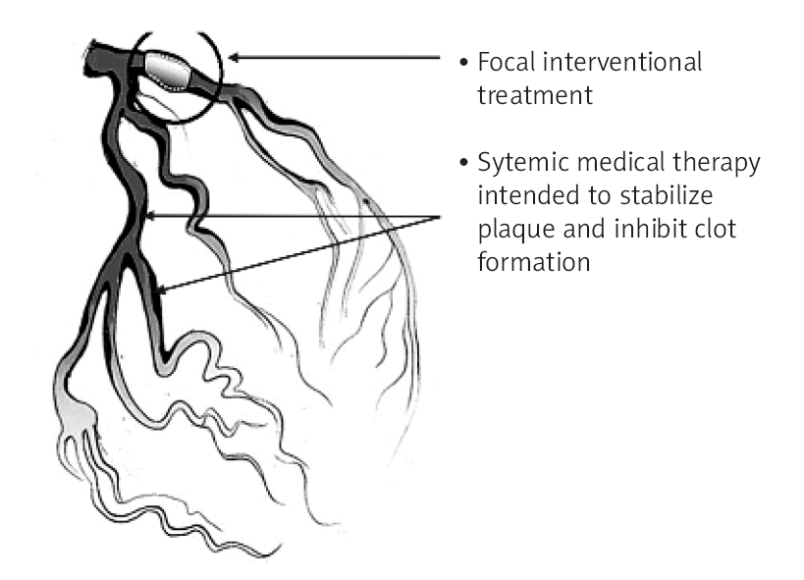
La Gestione Clinica del
«Rischio di Recidiva Ischemica»
Intervento “focale” con PCI
Intervento “sistemico” con
terapia medica per stabilizzare
altre lesioni potenzialmente
attive
A. Kumar, C.P. Cannon. Arch Med Sci 2007;3:S115-S125

Slide 9
Obiettivi della Prevenzione Secondaria dopo Sindrome Coronarica Acuta
Prevenire sviluppo e progressione della disfunzione ventricolare sinistra verso lo scompenso cardiaco.
Ridurre il rischio di recidive ischemiche acute legate:
Progressione della malattia vascolare aterosclerotica,
Compromissione della pervietà degli stent o dei by-pass.
3. Ridurre il rischio di morte cardiaca improvvisa.
4. Ridurre il carico ischemico.
JACC 2012; 60:e44–e164
European Heart Journal (2013) 34, 2949–3003

Slide 10
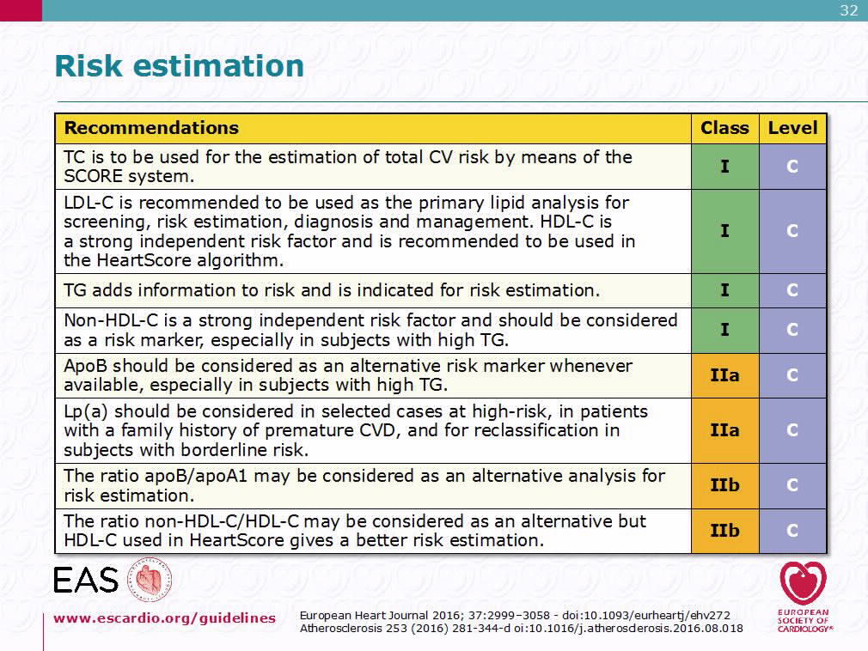

Slide 11
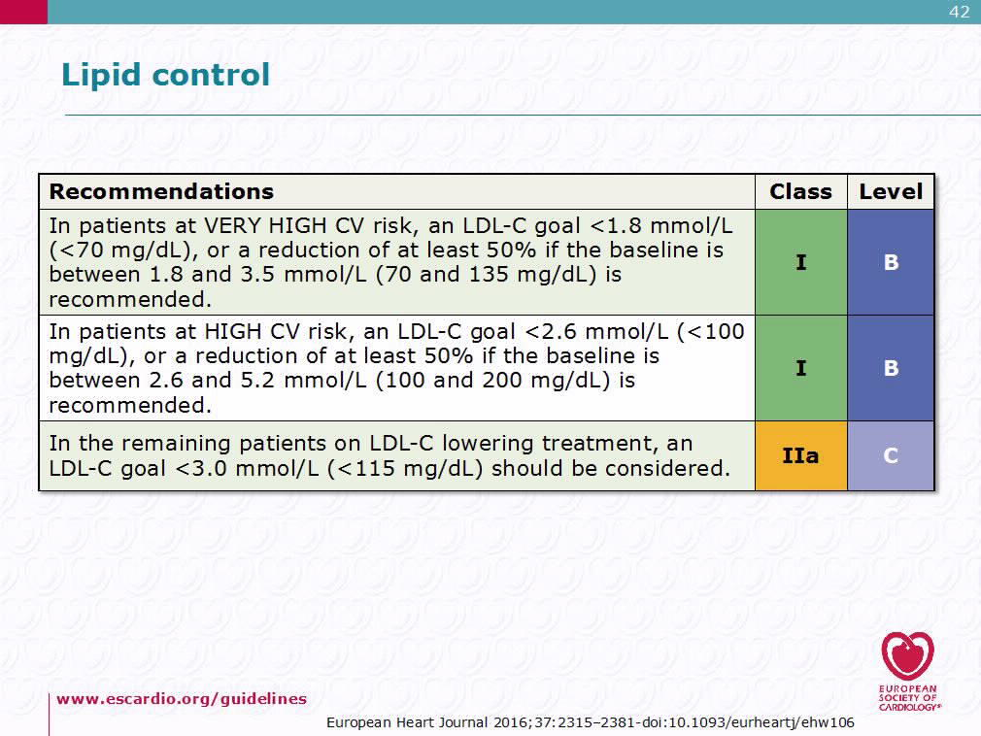

Slide 12
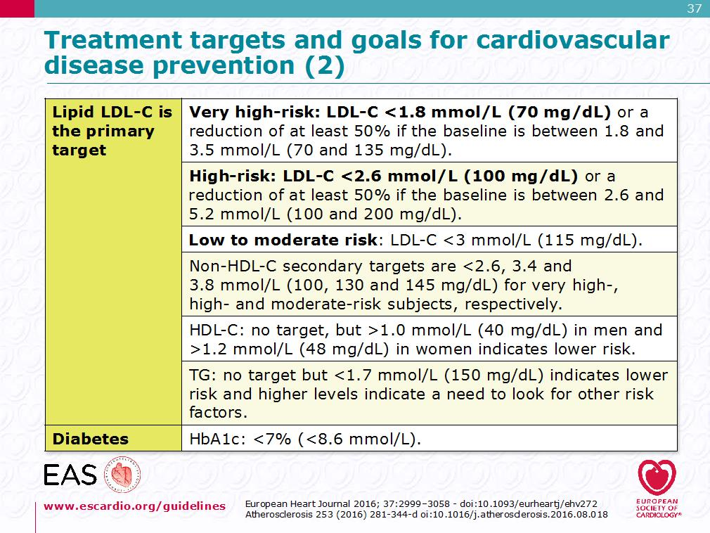

Slide 14
All therapies that lower low-density lipoprotein (LDL) act via the LDL receptor pathway to up-regulate LDL receptors and thus increase LDL clearance

Slide 15
Statin therapy is the cornerstone of lipid-lowering treatment
There is indisputable evidence that statins reduce the risk of cardiovascular disease, both in patients without or with a previous major cardiovascular event (MI or stroke).
There is also evidence that lower LDL cholesterol levels achieved with more intensive statin therapy may result in greater reduction in cardiovascular events.
1. Baigent C, Keecah A, Kearney PM et al. Efficacy and safety of cholesterol-lowering treatment: prospective meta-analysis of data from 90,056 participants in 14 randomised trials of statins. Lancet 2005;366:1267-78.
2. Baigent C, Blackwell L, Emberson J et al. Efficacy and safety of more intensive lowering of LDL cholesterol: a meta-analysis of data from 170,000 participants in 26 randomised trials. Lancet 2010;376:1670-81.

Slide 16
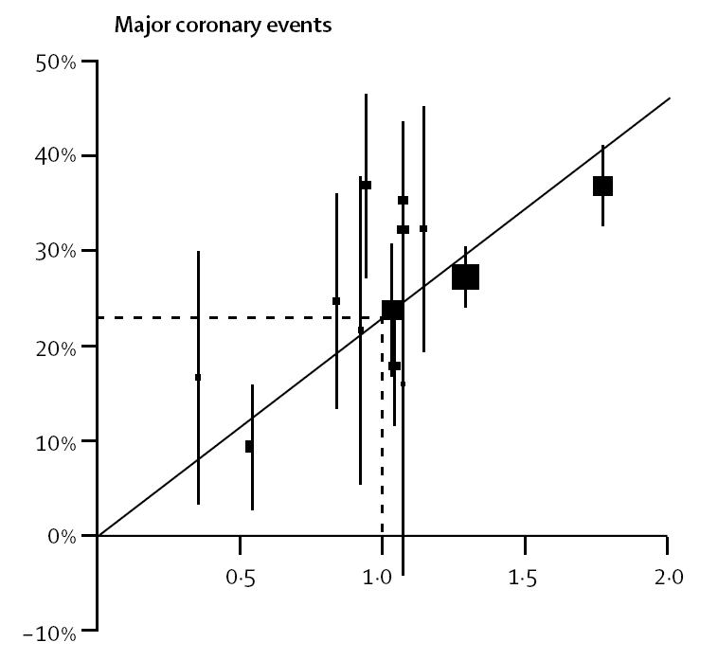
Relative risk reduction for major coronary events
La riduzione del Rischio Relativo risulta indipendente dai livelli iniziali di LDL-C e dalle caratteristiche cliniche del paziente
Ogni riduzione di LDL-C di 38 mg/dl si associa ad una riduzione del Rischio Relativo del 24%
LDL Cholestrol reduction (mmol/l)
Baigent C, et al, Cholesterol Treatment Trialists’ (CTT) Collaborators.
Lancet 2005;366:1267–1278.
Notes:
Retta di meta-regressione che riassume i risultati dei trial con statine nei diversi contesti clinici.

Slide 17
A systematic review and meta-analysis of the therapeutic equivalence of statins
Ezetimibe

Slide 18
General Recommendations for the Pharmacological Management of Hypercholesterolemia
2016 European Guidelines on cardiovascular disease prevention in clinical practice. European Heart Journal (2016) 37, 2315–2381
2016 ESC/EAS guidelines for the management of dyslipidaemias.
European Heart Journal (2016) doi:10.1093/eurheartj/ehw272.

Slide 19

START
STable Coronary Artery
Diseases RegisTry
Observational, prospective, multicentre, nationwide registry aimed to evaluate the
current management and treatment
of patients with a diagnosis of stable CAD
De Luca L, et al. Eur J Prev Cardiol. 2018;25:43

Slide 20
Inclusion Criteria
Patients with stable CAD, including those with at least 1 of the following clinical conditions:
  Prior ACS (>30 days from enrolment)
  Previous CABG
  Previous PCI
  Stable Angina
  Documented ischemia at stress test
  Elective procedures of revascularization (including staged procedures)
De Luca L, et al. Eur J Prev Cardiol. 2018;25:43

Slide 21
Type of Enrollment
5070 patients
n. 1432 (28%)
Admission
n. 181 (4%)
Day Hospital
(DH)
n. 3457 (68%)
Outpatient visit
De Luca L, et al. Eur J Prev Cardiol. 2018;25:43

Slide 22
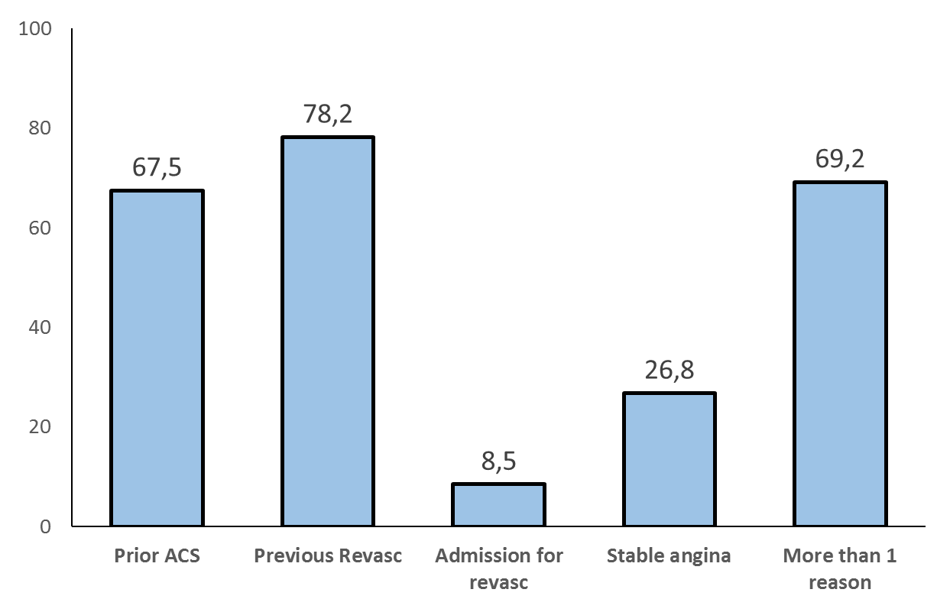
Entry Criteria
De Luca L, et al. Eur J Prev Cardiol. 2018;25:43

Slide 23
Baseline Characteristics
 | Total (n. 5070)
Females, n. (%) | 1008 (20)
Age (years), mean±SD | 68±11
Age >75 years, n. (%) | 1283 (25)
BMI median [IQR] | 26.9 [24.7-29.4]
BMI >25 kg/m², n. (%) | 3597 (71)
SBP (mmHg), mean±SD | 130±16
SBP >140 mmHg, % | 877 (17)
HR (bpm), mean±SD | 66±11
HR >70 bpm, % | 1322 (26)

Slide 24
Clinical history
 | Total (n. 5070)
Diabetes mellitus, n. (%) | 1558 (31)
Active smoker, n. (%) | 887 (18)
Arterial Hypertension, n. (%) | 4024 (79)
Hypercholesterolemia, n. (%) | 3790 (75)
Unknown familial hypercholest., n. (%) Familial hypercholesterolemia, n. (%) Confirmed by ESC/EAS score, n. (%) Unlikely, n. (%) Possible, n. (%) Probable, n. (%) Definite, n. (%) | 1040 (21) 144 (3) 136 (94) 12 (9) 40 (29) 69 (51) 15 (11)

Slide 25
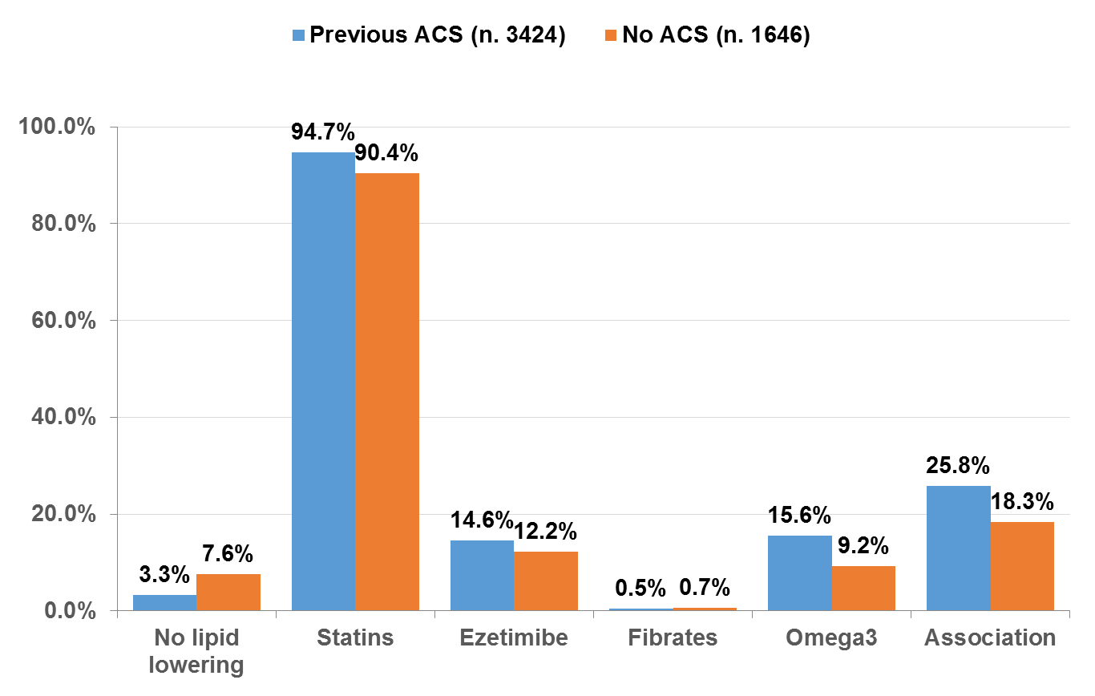
Lipid-lowering therapy
by CAD
<.0001
<.0001
0.02
<.0001
<.0001
0.36
De Luca L, et al. Eur J Prev Cardiol. 2018;25:43

Slide 26
Lipid-lowering therapy
Pts treated with statins
 | Total (n. 4731) | Dosage (mg/die) Median [IQR] | Dosage (mg/die) Mean ± SD
Atorvastatin | 73 % | 40 [20-40] | 41 ± 21
Simvastatin | 13 % | 20 [20-40] | 26 ± 12
Rosuvastatin | 12 % | 10 [10-20] | 14 ± 7
Pravastatin | 1 % | 40 [20-40] | 32 ± 11
Lovastatin | 0.3 % | 30 [20-40] | 30 ± 10
Fluvastatin | 0.2 % | 80 [80-80] | 71 ± 25
Notes:
Percentuali sui trattati con statine
Dosaggio si riporta media +-SD e mediana con percentili

Slide 27
Laboratory Examinations
 | Total (n. 5070)
Hemoglobin <12 g/dL, % available for 4139 pts (82%) | 17
Creatinine >1.5 mg/dL, % available for 4130 pts (81%) | 9
Cholesterol >200 mg/dL, % available for 3669 pts (72%) | 12
Cholesterol LDL >70 mg/dL, % available for 3210 pts (63%) | 66
Cholesterol HDL <40 mg/dL, % available for 3423 pts (68%) | 35
Triglycerides > 150 mg/dL, % available for 3557 pts (70%) | 26
Glycemia >126 mg/dL, % available for 3778 pts (75%) | 22
Uricemia >7.0 mg/dL, % available for 2387 pts (47%) | 17
Notes:
At least 1 lab examination available for 4436/5070, 88%

Slide 28



EYESHOT (EmploYEd antithrombotic therapies in patients with acute coronary Syndromes HOspitalized in iTaly) Post-MI Registry
Prospective, multicenter, observational, nationwide survey of consecutive unselected patients with a prior MI admitted in Italian Cardiology units and/or hospital ambulatory clinics, during a period of 3 months.
De Luca L, Int J Cardiol, 19 August 2018

Slide 29
Inclusion/Exclusion Criteria
Inclusion criteria
All consecutive patients of any age and gender with a history of prior MI (non-ST elevation, NSTEMI or ST-elevation, STEMI) occurring between 12 months and 3 years from the last MI event, admitted to cardiology units and/or hospital ambulatory clinics, will be included.
Exclusion criteria
- Patients aged less than 18 years
- Patients with an MI occurred in the 12 months prior enrolment
- Patients with known pregnancy, breast-feeding, or intend to become pregnant during the study period (or other conditions that would contraindicate the use of some drugs)
- Patients included in randomized or observational studies which prescribe by protocol specific diagnostic or therapeutic approaches
- Patients not giving informed consent.
De Luca L, Int J Cardiol, 19 August 2018

Slide 30
3 months in each center
March 1st, 2017: First patient in
December 16th, 2017: Last patient in
Enrollment
1633 patients
n. 260 (16%)
Admission
n. 11 (1%)
Day Hospital
(DH)
n. 1362 (83%)
Outpatient visit
De Luca L, Int J Cardiol, 19 August 2018

Slide 31
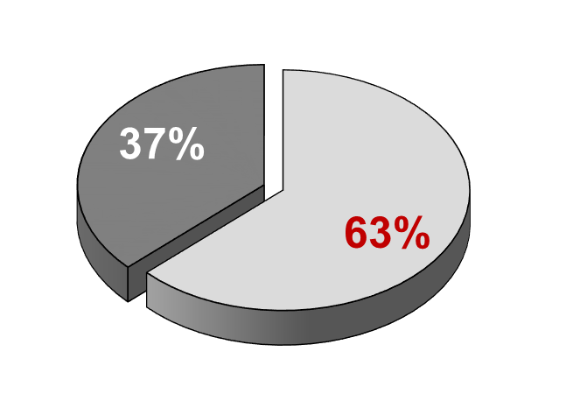
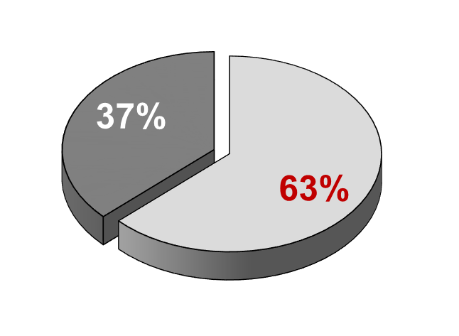
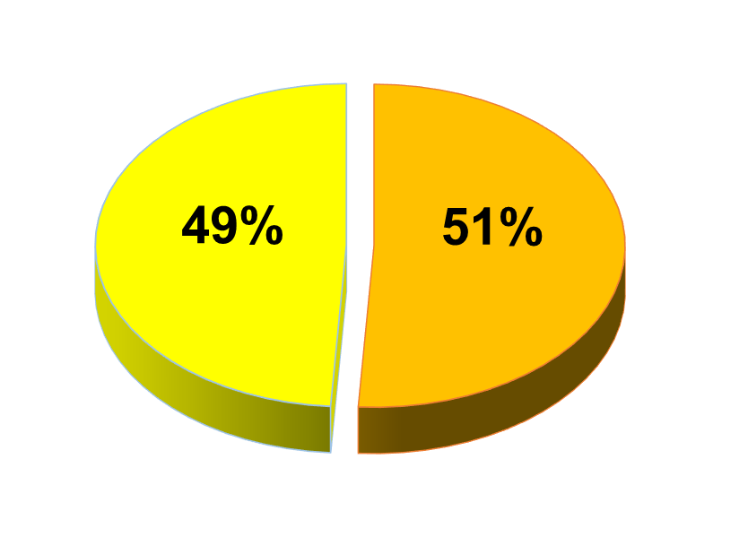
Enrollment criteria
NSTEMI
(n. 808)
STEMI
(n. 825)
24-36 months
24-36 months
12-24 months
12-24 months

Slide 32
Baseline characteristics
 | Months from last AMI
 | (12-24] (n=1028) | (25-36] (n=605) | p
Females, n. (%) | 198 (19) | 121 (20) | 0.72
Age (years), mean±SD | 65±12 | 67±11 | 0.02
Age >75 years, n. (%) | 225 (22) | 151 (25) | 0.15
BMI median [IQR] | 26.7 [24.7-29.4] | 26.5 [24.7-29.1] | 0.97
BMI >25 kg/m², n. (%) | 714 (69) | 422 (70) | 0.90
SBP (mmHg), mean±SD | 130±17 | 130±17 | 0.69
HR (bpm), mean±SD | 67±12 | 67±12 | 0.92
Symptoms in the last 2 months, n (%) | 251 (24) | 145 (24) | 0.84

Slide 33
Clinical history (1)
 | Months from last AMI
 | (12-24] (n=1028) | (25-36] (n=605) | p
Diabetes mellitus, n. (%) | 281 (27) | 180 (30) | 0.27
Active smoker, n. (%) | 197 (19) | 111 (18) | 0.56
Hypercholesterolemia, n. (%) | 754 (73) | 458 (76) | 0.32
Prior multiple MI, n. (%) ≥3 episodes | 181 (18) 49 (5) | 112 (19) 25 (4) | 0.66
Prior PCI, n (%) ≥2 stents | 925 (90) 502 (49) | 532 (88) 279 (46) | 0.31
Prior CABG, n (%) | 91 (9) | 80 (13) | 0.005
Prior revascularization, n (%) | 955 (93) | 567 (94) | 0.35
De Luca L, et al. submitted

Slide 34
Clinical history (2)
 | Months from last AMI
 | (12-24] (n=1028) | (25-36] (n=605) | p
Arterial Hypertension, n. (%) | 807 (79) | 476 (79) | 0.91
Chronic renal failure, n. (%) | 129 (13) | 74 (12) | 0.87
COPD, n. (%) | 125 (12) | 62 (10) | 0.26
History of HF, n (%) | 164 (16) | 89 (15) | 0.52
History of atrial fibrillation, n. (%) | 129 (13) | 80 (13) | 0.68
History of peripheral artery disease, n. (%) | 64 (6) | 48 (8) | 0.19
History of TIA/Stroke, n. (%) | 38 (4) | 30 (5) | 0.21
History of Major Bleeding, n. (%) | 31 (3) | 19 (3) | 0.88

Slide 35
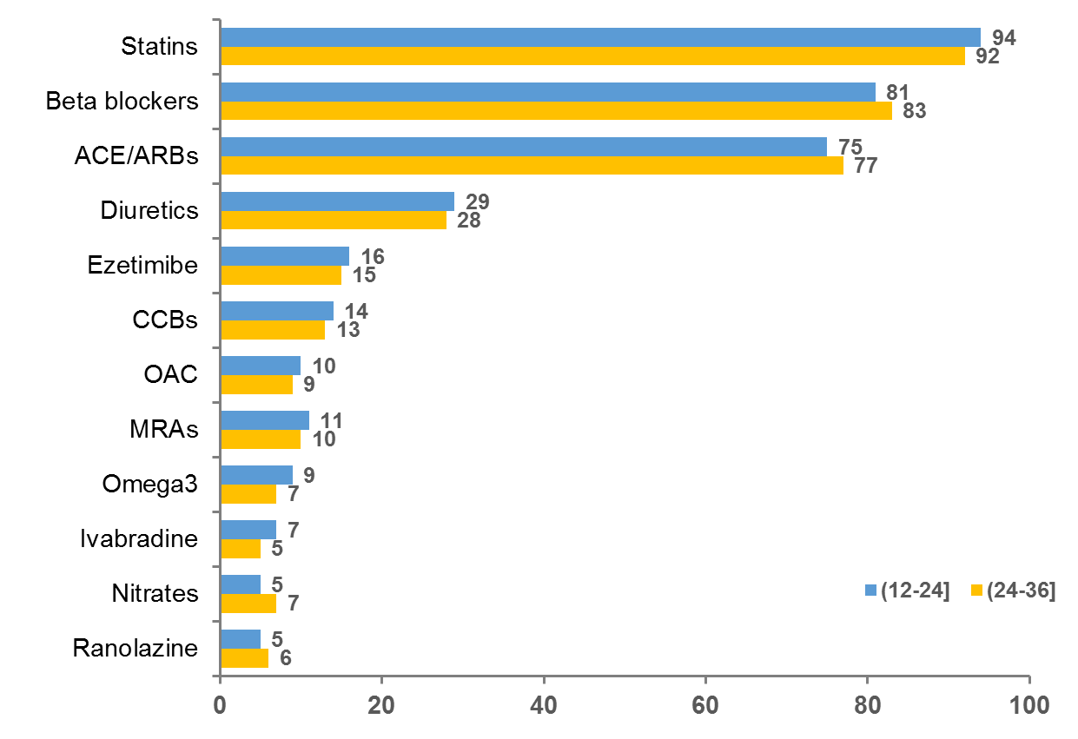
Cardiovascular drugs
Months from last MI (12-24] (n=1028) vs (24-36] (n=605)
%
Cardiovascular drugs not reported have been used in less than 5% of the cases
De Luca L, Int J Cardiol, 19 August 2018

Slide 36
Laboratory Examinations
 | (12-24] (n=1028) | (25-36] (n=605) | p
Hb (gr/dl), mean±SD available for 1110 (68.0%) pts | 13.6±1.8 | 13.7±1.7 | 0.44
Creatinine (mg/dl), mean±SD available for 1119 (68.5%) pts | 1.1±0.5 | 1.1±0.4 | 0.31
Total cholesterol (mg/dl), mean±SD available for 1000 (61.2%) pts | 145±37 | 146±34 | 0.59
LDL cholesterol, mean±SD available for 903 (55.3%) pts | 77±30 | 76±28 | 0.79
Triglycerides (mg/dl), median (IQR) available for 979 (60.0%) pts | 105 [80-151] | 106 [80-140] | 0.55
Glycemia (mg/dl), mean±SD available for 993(60.8%) pts | 112±33 | 112±31 | 0.40

Slide 37
Prevenzione Secondaria
Usiamo le Statine (95% dei casi),
In generale le Statine sono sotto-dosate,
Siamo lontani dai target raccomandati (LDL-C<70 mg/dl) almeno nel 50-60% dei casi,
Nonostante le evidenze, utilizziamo poco Ezetimibe (12-15% dei casi)

