Slide 1
Epidemiologia del colangiocarcinoma: da rarità a tumore frequente
Domenico Alvaro
Università Roma, “Sapienza”.
Tumori delle vie biliari:problematiche mediche e sociali
28 Nov. 2018, Sala AuditoriumMinistero della Salute, Roma

Slide 2
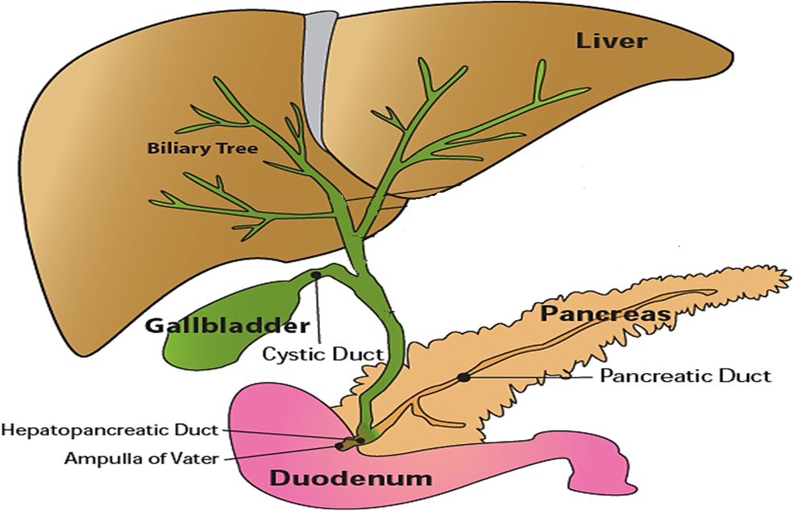
CHOLANGIOCARCINOMA (CCA): recente classificazione basata sulla localizzazione anatomica (EASL, ILCA guidelines 2013/2014, ENS-CCA)
INTRAHEPATIC (iCCA)
10-20%
second-order bile ducts
iCCA = ≈ 10% of primitive liver cancer
iCCA:HCC = 1:9
This scenario is changing !
Perihilar
(pCCA)
70-85%
Klatskin t.
Distal (dCCA)
2-5%

Slide 3
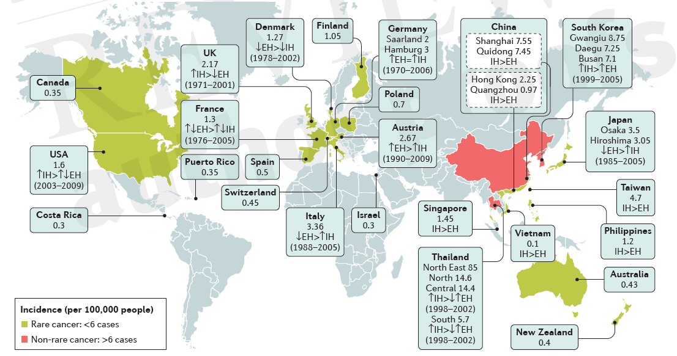
CCA: incidenza (casi/100,000), Banales JM…Alvaro D. Nature Rev. 2016.
2014
IH > EH
EH > IH

Slide 4
CCA: trend temporale di incidenza (Banales JM…Alvaro D. Nature Rev. 2016).
2014
↑ IH , ↓ EH
↑ IH, ↑EH

Slide 5
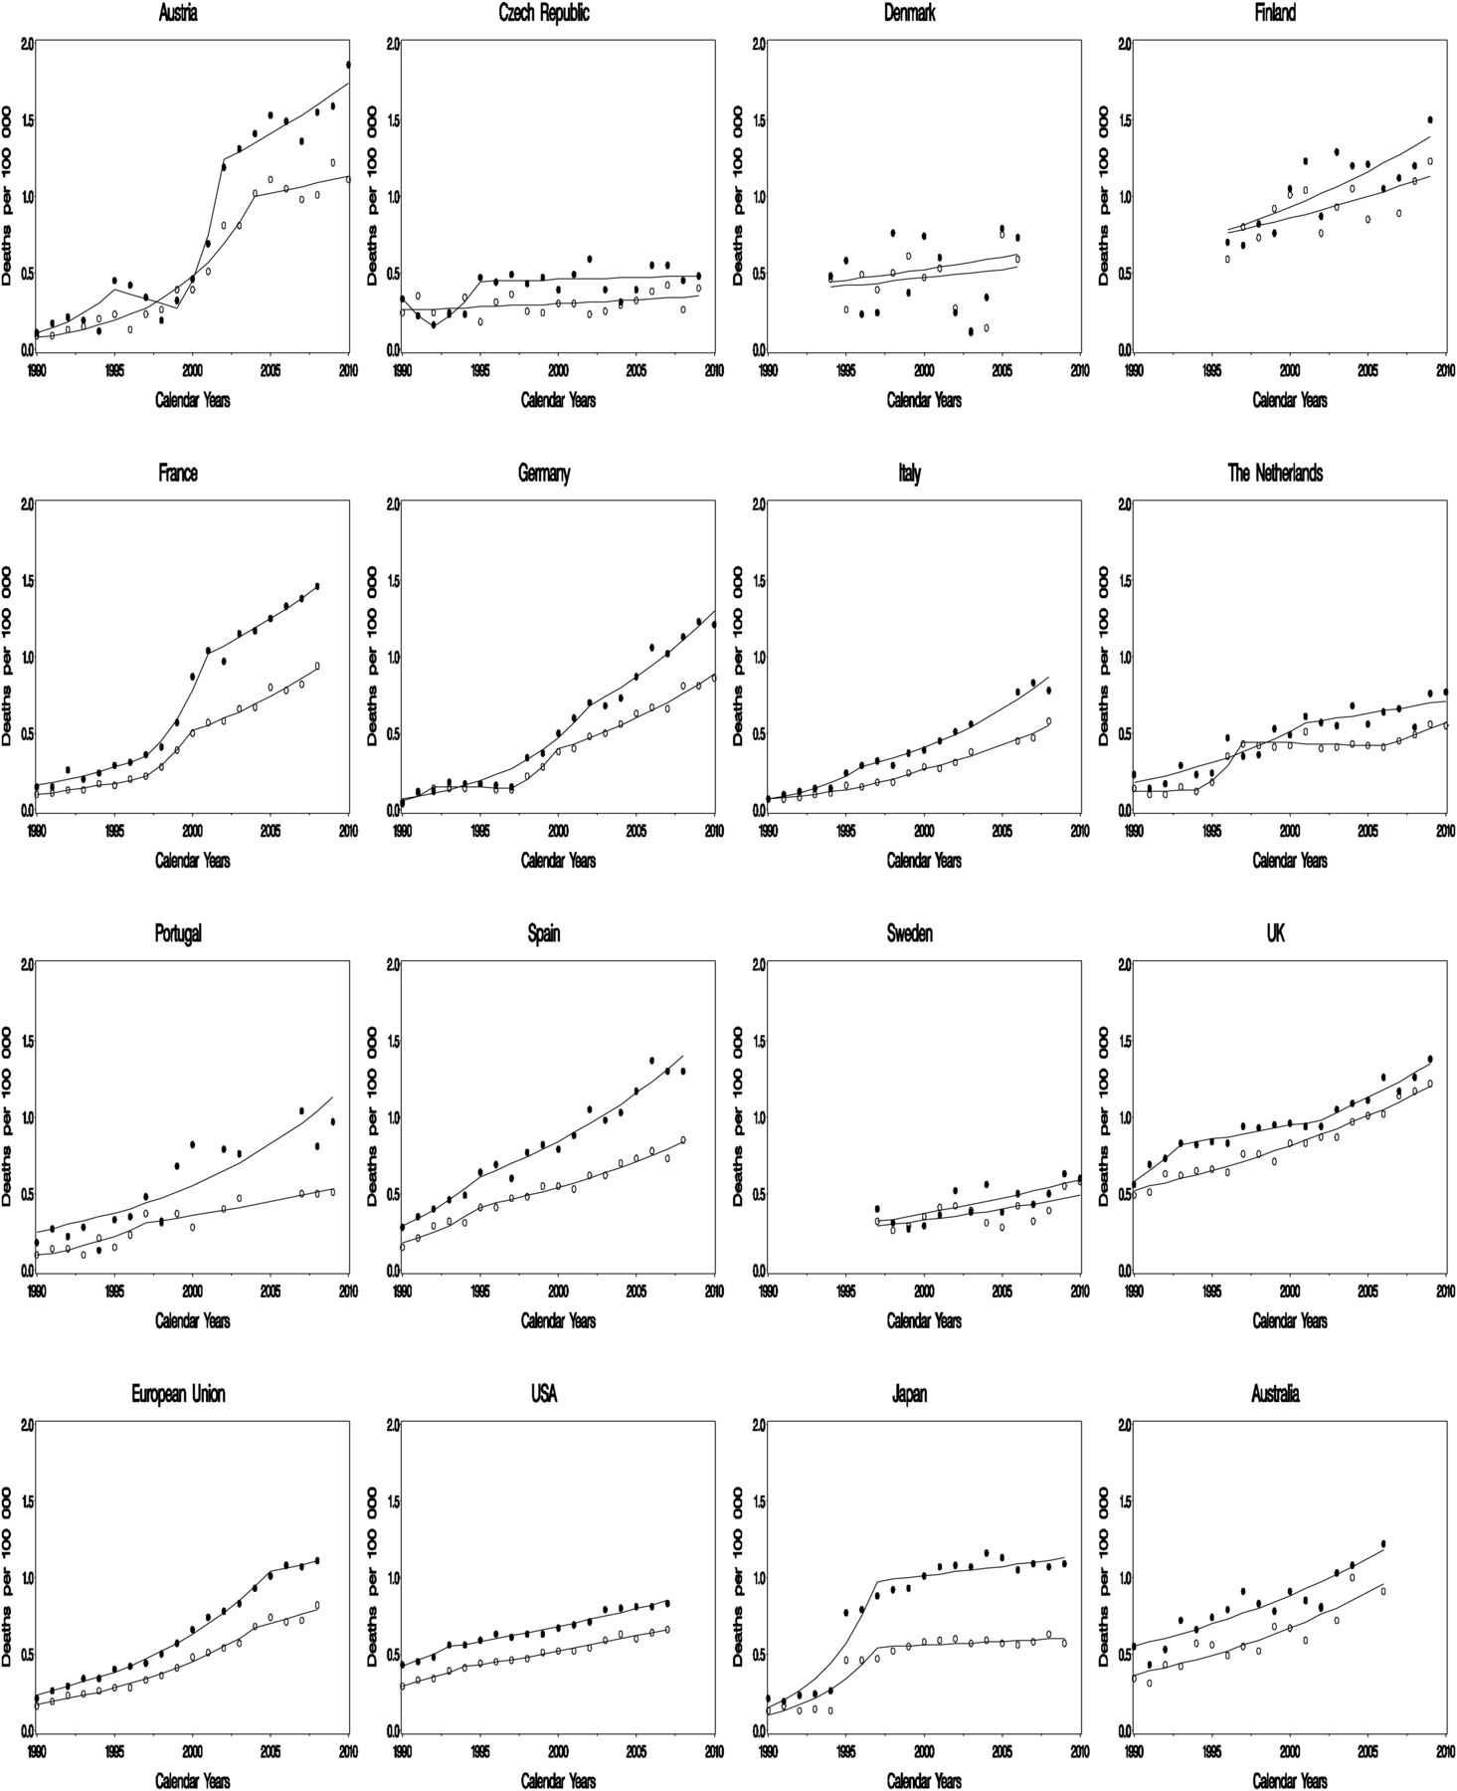
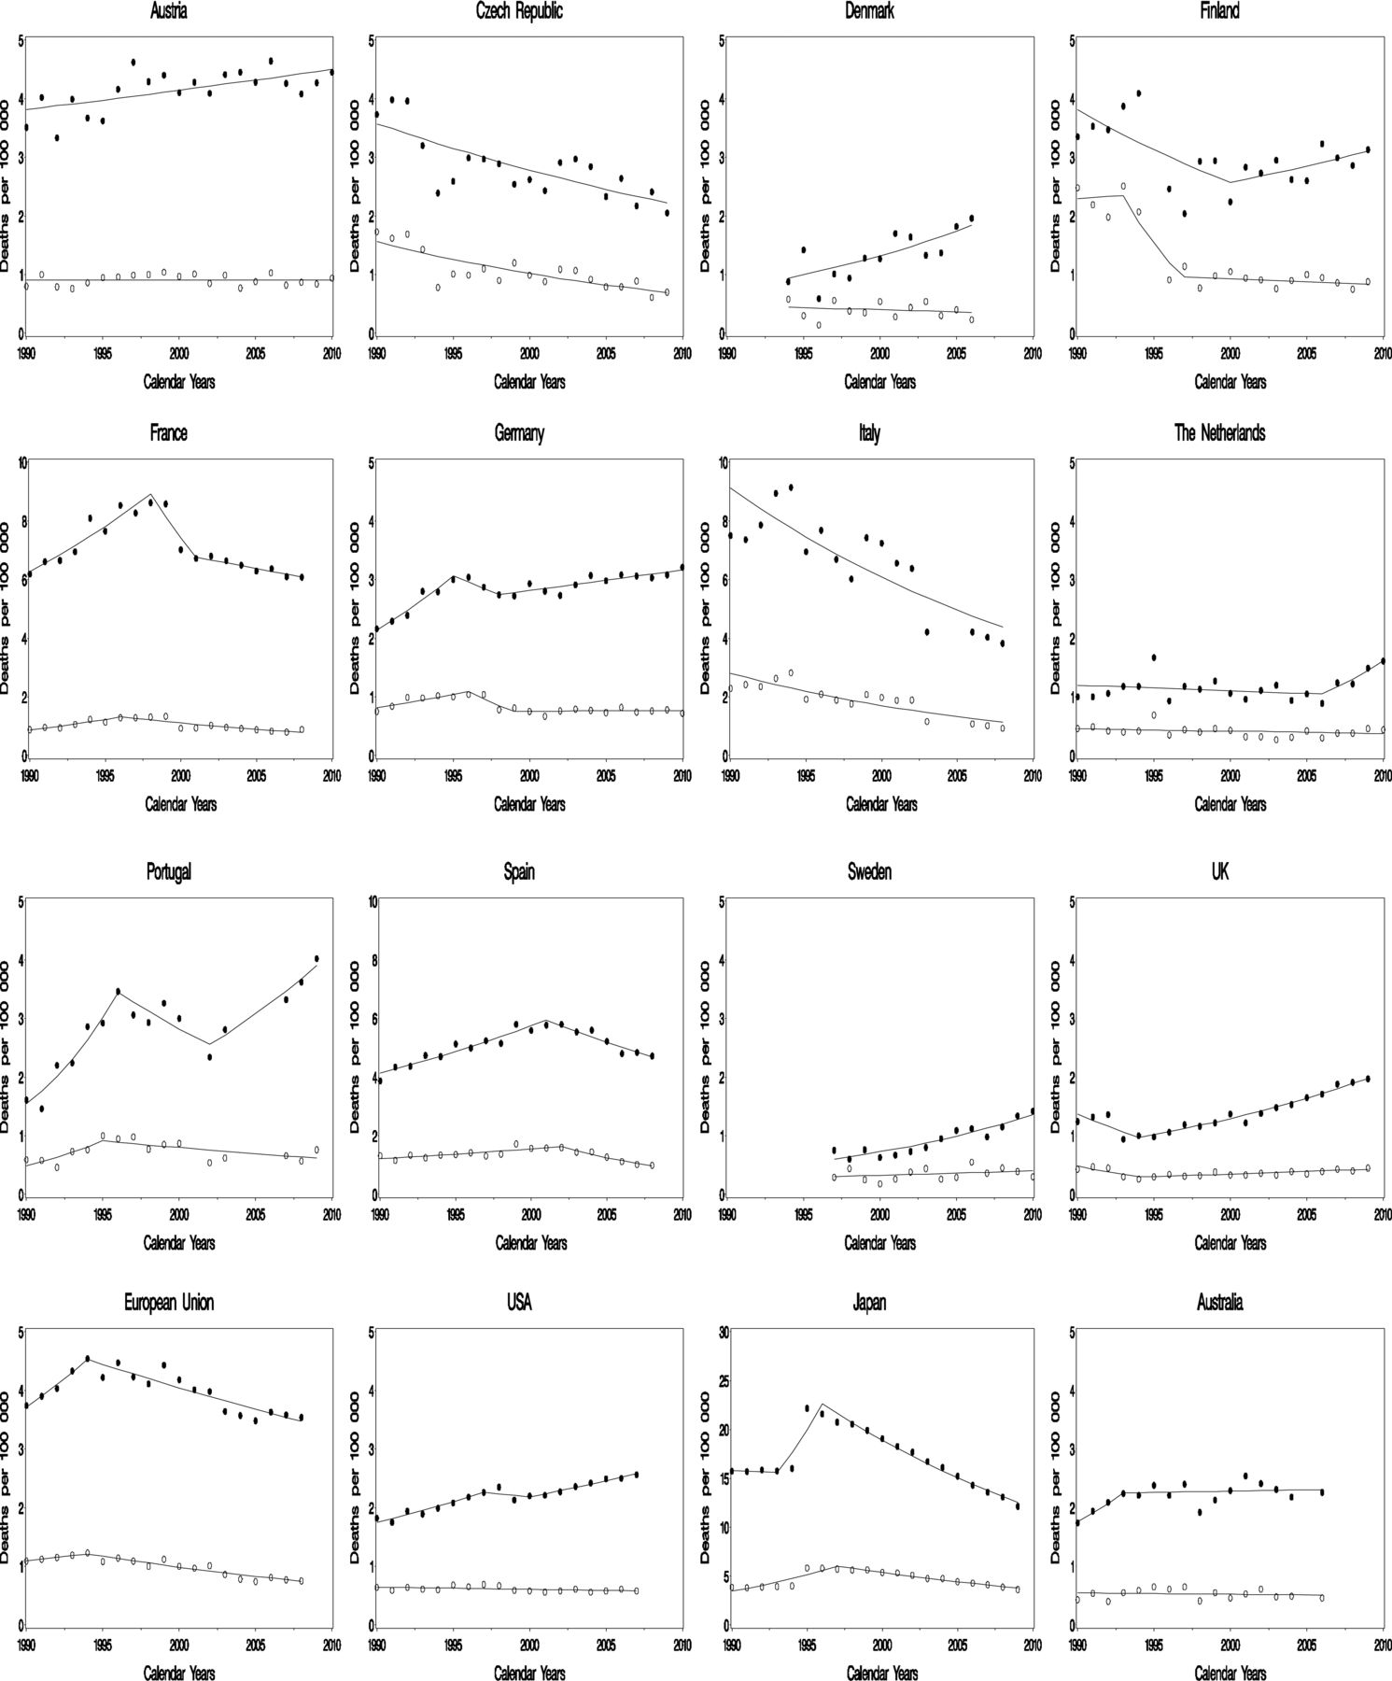
Joinpoint analysis for age-standardized (world population) death certification rates from intrahepatic cholangiocarcinoma (ICC) in 12 major selected European countries, the European Union (EU), the United States, Japan, and Australia, 1990–2010.
Joinpoint analysis for age-standardized (world population) death certification rates from primary liver cancer (PLC) in 12 selected European countries, the European Union (EU), the United States, Japan, and Australia, 1990–2010.

Slide 6
L’aumento di incidenza di iCCA non è reale perché: - misclassificazione di pCCA come iCCA ? - miglioramento delle tecniche diagnostiche ? - minore diagnosi di carcinoma del fegato da sede primaria sconosciuta (CUP).
Reale o falso incremento dei incidenza (doppia negli ultimi 25 anni) di iCCA ?
Possibili errori metodologici ?

Slide 7
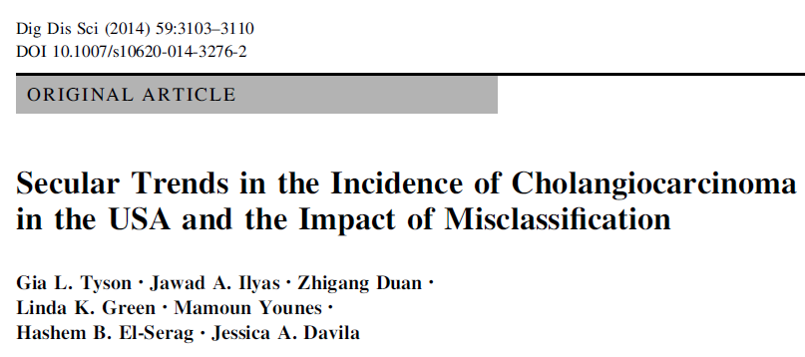
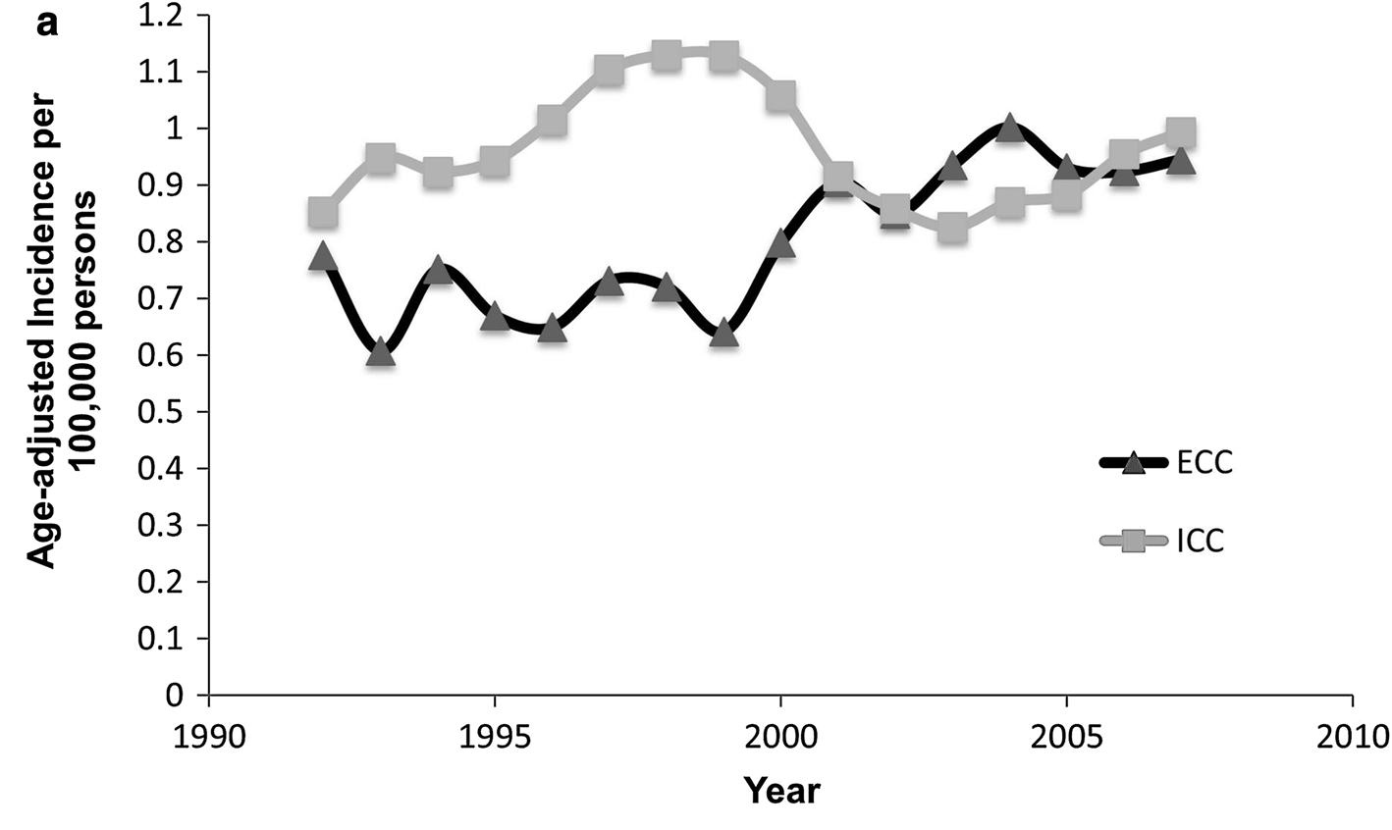
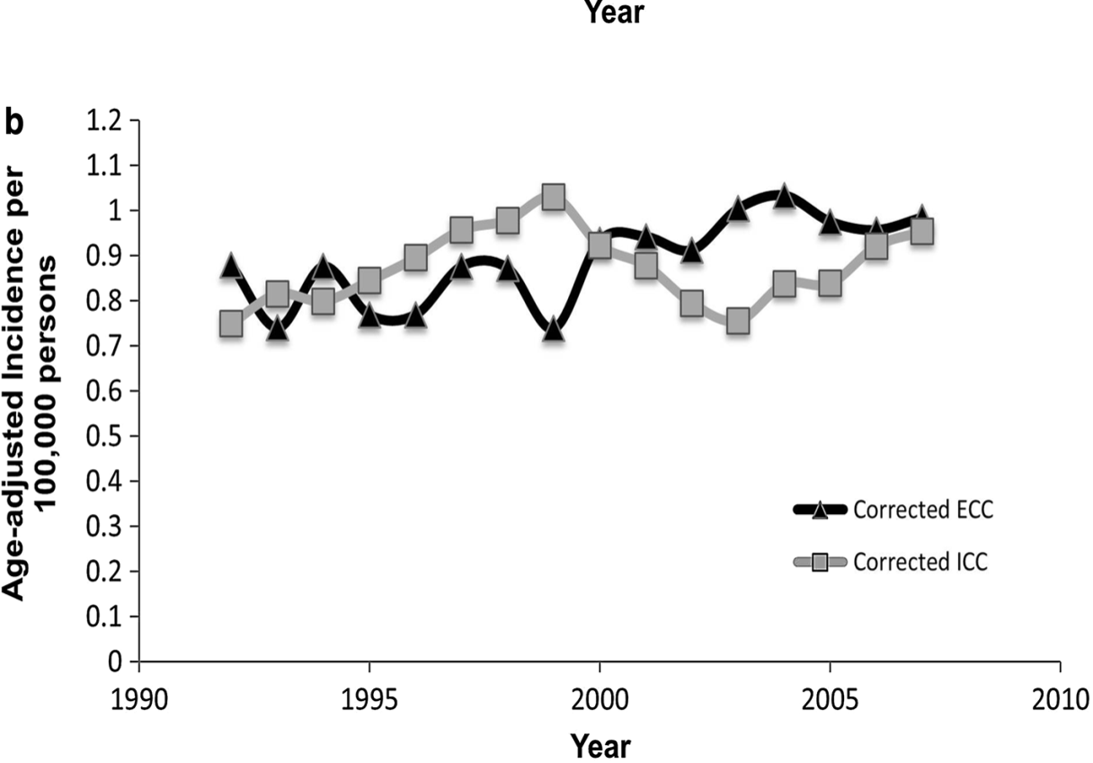
13 SEER registries
(9,840 CC cases, 1992–2007)

Slide 8
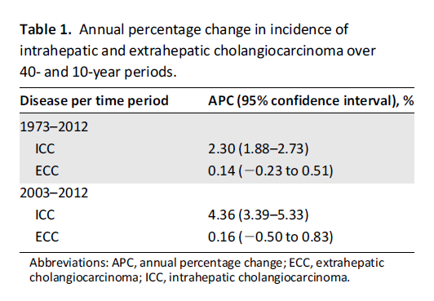
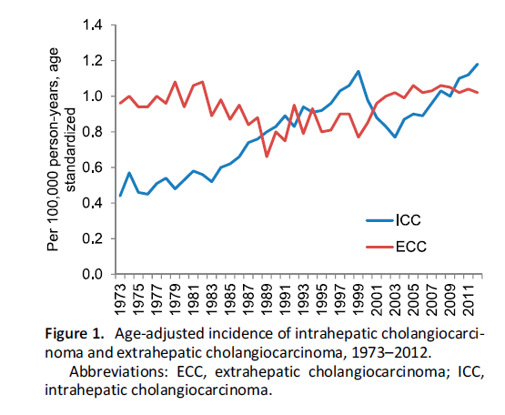

Slide 9
Incidenza di iCCA ed eCCA da 9 registri italianii (1988-2002)
e 13 registri (1997-2005)(Alvaro D. et al. DLD 2009)
9 registries
13 registries
eCCA
+ 3%/year
iCCA
+ 6%/year
+ 4%/year

Slide 10
Real or false increasing incidence of IH-CCA ?
Bias ???
Reale o falso incremento dei incidenza (doppia negli ultimi 25 anni) di iCCA ?
Possibili errori metodologici ?
L’aumento di incidenza di iCCA non è reale perché: - misclassificazione di pCCA come iCCA ? - miglioramento delle tecniche diagnostiche ? - minore diagnosi di carcinoma del fegato da sede primaria sconosciuta (CUP).

Slide 11
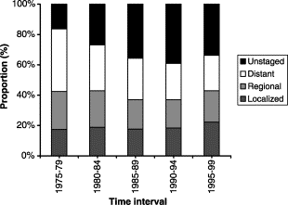
Proporzione di pazienti con differenti stradi di malattia alla diagnosi (Shaib Y. J. Hepatology 2004).

Slide 13
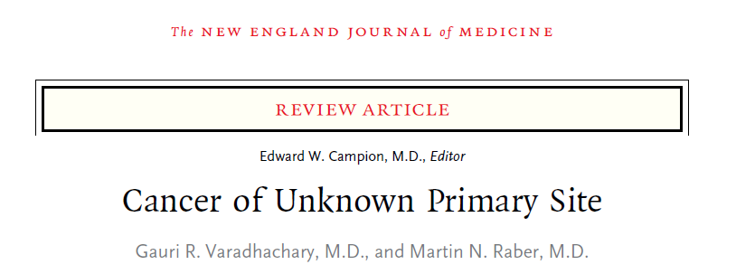
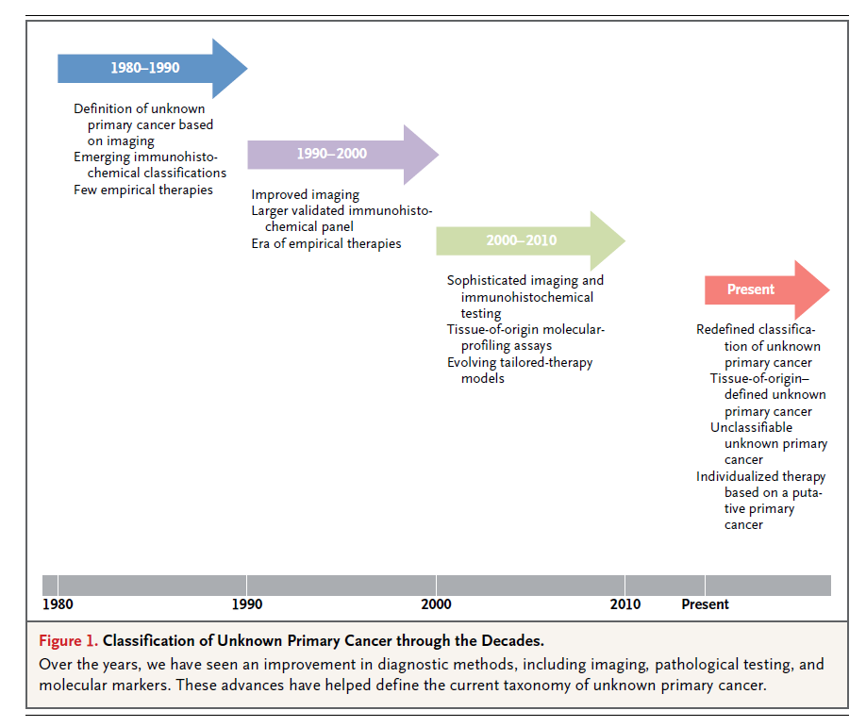
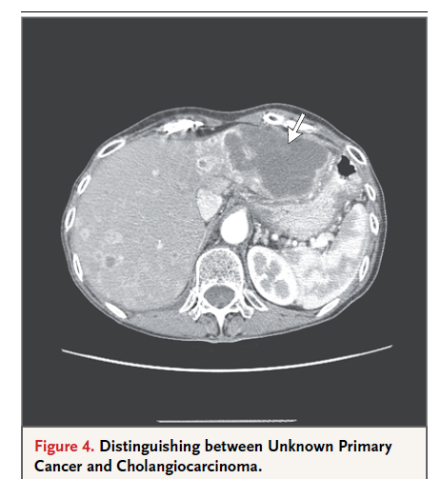

Slide 14
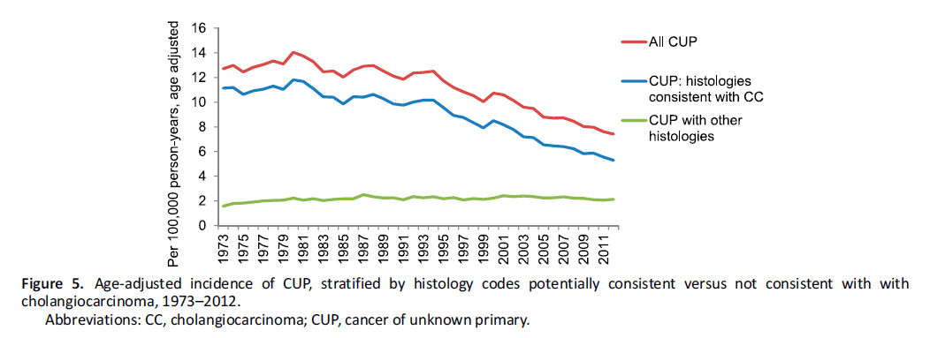
American Hepato-Pancreato-Biliary Association

Slide 15
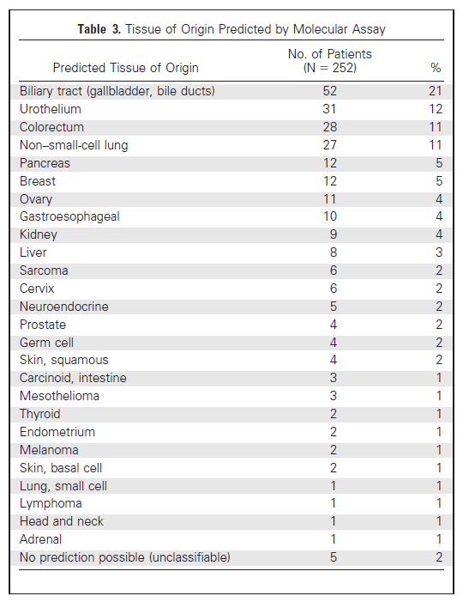
92-gene biomarker panel (RT-PCR–based protocol) and computational approach ….

Slide 16
American Hepato-Pancreato-Biliary Association
USA, incidenza iCCA, anno 2005
0.6/100,000 iCCA +
1.4/100,000 CUP-iCCA
2/100,000 vs HCC 5-6/100,000 (1:3)
Italia, incidenza iCCA, anno 2005
1/100,000 iCCA +
2.1/100,00 0 CUP-iCCA
3.12/100,000 vs HCC 12,4 (1:4)

Slide 17
ENS-CCA
Network Europeo per lo Studio
del COLANGIOCARCINOMA (CCA)
Grant Europeo COST_ACTION (5 anni, circa 1.5 M. Euro)
N. 40 Gruppi di Ricerca da N. 13 paesi europei
Austria, Denmark, France, Germany (N. 3 research groups), Italy (N. 6 research groups), The Netherlands, Norway,
Poland, Portugal, Spain (N. 4 research groups), Sweden, Switzerland, United Kingdom (N. 3 research groups)
N. 7 centri USA come International Advisors/Collaborators

Slide 18
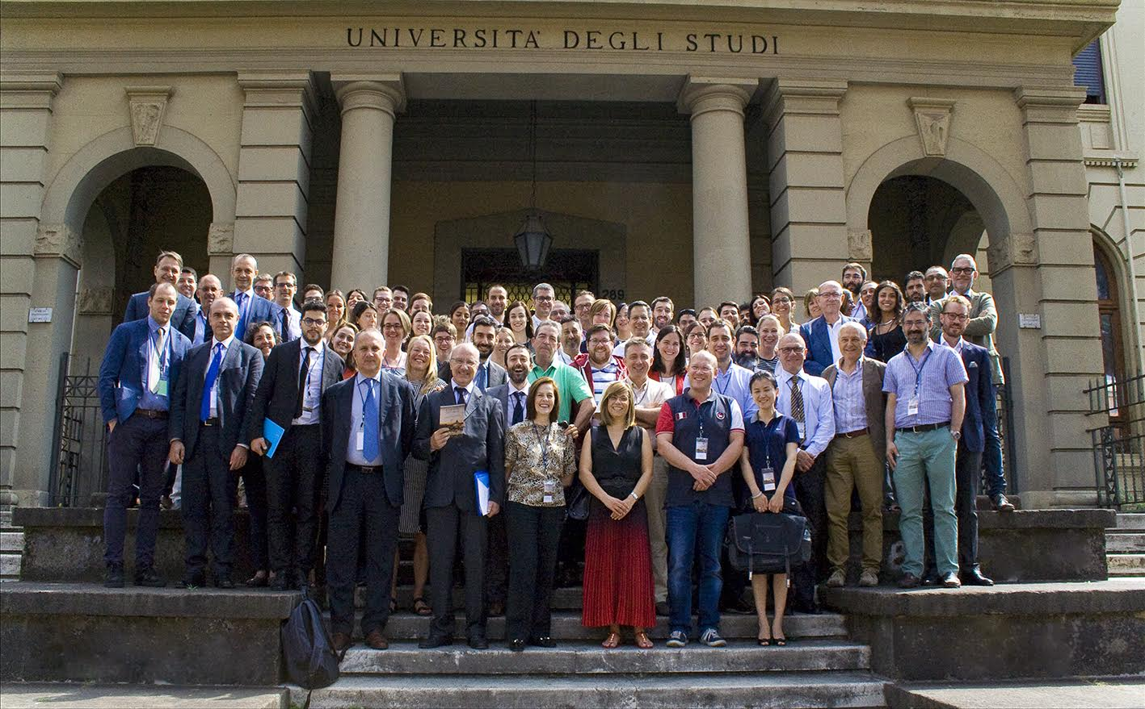
II Biannual ENSCCA Congress
N. 168 attenders from N. 12 european countries,
12 from USA
N. 55 speakers (N. 8, USA)
June 21-23, 2018 · Rome
Organizers
D. Alvaro, J. Banales, A. Benedetti, E. Gaudio, M. Marzioni.

Slide 19
European CCA registry: status
1,604 patients
(14 Institutions)

Slide 20
General info
Gender
Age
Median: 68 years
Mean: 63.95 years (Q1:58.0 / Q3:75.0)
Women
Men
(695)
(909)
Ethnic group
Not reported
39 (3.2%)
Caucasian
1125 (93.2%)
African
4 (0.3%)
Asian
27 (2.2%)
Other
12 (1.0%)

Slide 21
General info
Associated pathologies ! Risk factors (?)
Inflammatory
PSC
56 (3.8%)
Hepatolithiasis
3 (0.2%)
Biliary tract stone
54 (3.6%)
Biliary-enteric anastomosis
3 (0.2%)
Liver cirrhosis
58 (3.9%)
Cholecystectomy
63 (4.2%)
Imflammatory bowel disease (IBD)
38 (2.6%)
Other
37 (2.5%)
Drug/Toxins
Infectious
Smoking
224 (20.3%)
Hepatitis C
23 (2.0%)
Alcohol
167 (15.2%)
Hepatitis B
21 (1.8%)
Other
7 (0.6%)
HIV
5 (0.4%)
Other
12 (1.0%)

Slide 22
General info
Body Mass Index (BMI)
Median: 25
Mean: 25.55 (Q1:22.0 / Q3:28.0)
(NR:18.5-24.99)
Obesity (BMI ≥30)
Diabetes Mellitus
Yes
No
(233)
Yes
(265)
No
(913)
(867)

Slide 23
CCA features at diagnosis
Type of CCA (location)
Mass lesions
iCCA
(178)
Unicentric ≤ 3cm
(288)
pCCA
Unicentric > 3cm
dCCA
Multicentric
Mix CCA-HCC
(555)
Not reported
Not reported
(371)
(683)
(562)
(360)

Slide 24
Need International Consistency in Classification of CCA – to allow accurate monitoring of epidemiology
ICD-11 and ICD-O-3, are currently in use
In clinical practice and published literature, most CCA are pCCA (50-60%) and a minority are iCCA or dCCA (approx. 20% each)
ICD-10 (and previous) have separate topography codes for iCCA (C22.1) and dCCA (C24.0) but none for pCCA
ICD-O-3 (and previous) has no topographical code for pCCA. It has a morphological code for pCCA, and it does not have a specific morphological codes for iCCA or dCCA
Specialists in the field of CCA, whether pathologists, surgeons, radiologists, oncologists, gastro/hepatologists, epidemiologists etc. generally agree that CCA should be divided into three distinct sub-types: intra (iCCA), peri-hilar (pCCA) and distal/extrahepatic (dCCA), as each of these three sub-types has a distinct epidemiology, biology, prognosis and clinical management approaches

Slide 25
Need International Consistency in Classification of CCA – to allow accurate monitoring of epidemiology
ICD11 out this week will resolve this
Proposed:
2C18.0 Hilar Cholangiocarcinoma
2C12.10 Intrahepatic cholangiocarcinoma
2C15.0 Extrahepatic cholangiocarcinoma: Adenocarcinoma of biliary tract, distal bile duct
Similar needed for ICD-O 4 i.e. three separate topography/morphology codes for iCCA, pCCA and dCCA

